Slide 1

AIBridge
Lecture 3
Notes:
Hi everyone, my name is (name) and I will be teaching Lecture 6 today. So far, we have learned a few machine learning models, including linear regression and logistic regression. Today, we are going to learn five new models for classification.

Slide 2
Classification!
quick review
wine dataset
Fixed acidity
Volatile acidity
Citric acid
Residual sugar
Chlorides
Free sulfur dioxide
Total sulfur dioxide
Density
pH
Sulphates
Alcohol
a class
White = 1
Model
Red = 0
categorical label outputs are named “classes”
2
Notes:
Let’s quickly review what classification is, using the wine dataset. (click) The wine dataset consists of many different wines, and each wine is represented by several different features, including fixed acidity, volatile acidity, etc. We will put this dataset through a model (click), and our goal is to classify each wine into white wine, which is represented by 0, and red wine, which is represented by 1. Each output category is a class (click), which is why it’s called classification. In this case we have two classes. (click)

Slide 3
Classification!
quick review
that’s a lot of features!
wine dataset
Fixed acidity
Volatile acidity
Citric acid
Residual sugar
Chlorides
Free sulfur dioxide
Total sulfur dioxide
Density
pH
Sulphates
Alcohol
a class
White = 1
Model
Red = 0
categorical label outputs are named “classes”
3
Notes:
(click) In the wine dataset, we have 11 features for each wine, which is a lot of features! (click)

Slide 4
Fixed acidity
Volatile acidity
Citric acid
Residual sugar
Chlorides
Free sulfur dioxide
Total sulfur dioxide
Density
pH
Sulphates
Alcohol
Linear models might not be the best in some cases
4
Notes:
As you have more and more features with more complex data, (click) simple regression models (such as linear regression or logistic regression) might not work the best. Those models have assumptions about the distribution of the data. For example, the linear regression model assumes linearity. However, these assumptions may become invalid especially when you have more features. (click)

Slide 5
5 ML Models for Classification
1. Decision Tree
2. Random Forest
3. Support Vector Machine (SVM)
4. Naïve Bayes
5. K Nearest Neighbors
5
Notes:
That's why in addition to regression models, we have other models for classification. Today, we are going to study five of the more common classification models: decision tree, ... For each model, we will learn what it is and when to use it. Let's begin with the decision tree.

Slide 6
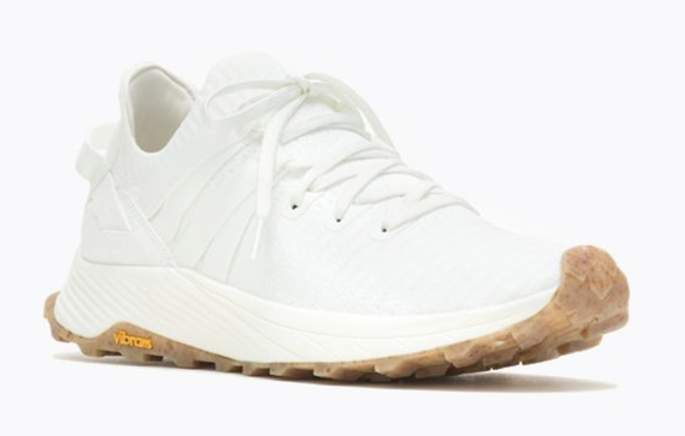
Decision Trees
6
Notes:
To understand this model, let’s take a look at an example. (click) Let’s say you want to decide whether to buy a pair of shoes. This is a classification task because we are classifying each shoe into two classes: yes, or no. To determine whether you would like to purchase a pair, you consider (click)

Slide 7
Decision Trees
Can I afford it?
7
Notes:
its price, (click)

Slide 8
Decision Trees
Can I afford it?
Is it comfortable?
8
Notes:
Comfort level, (click)

Slide 9
Decision Trees
Can I afford it?
Is it comfortable?
Is it fashionable?
9
Notes:
And fashion level. (click)

Slide 10
Decision Trees
Price
Comfort
Fashion
Purchased?
$70
4
6
No
$120
5
8
No
$20
4
4
No
$60
1
8
Yes
$60
6
3
No
$80
8
8
Yes
10
Notes:
Here is some sample data of different shoes with their price, comfort level, and fashion level, where the comfort and fashion level are rated from 0 to 10, with 0 being the least and 10 being the most. Additionally, for each shoe we know whether or not we would purchase it.
We are trying to find a model that can model the decision to buy or not based on these three factors. For this particular dataset, a linear model would not work, because the data is not linear. To see this more clearly, let's look at the graph. (click)

Slide 11
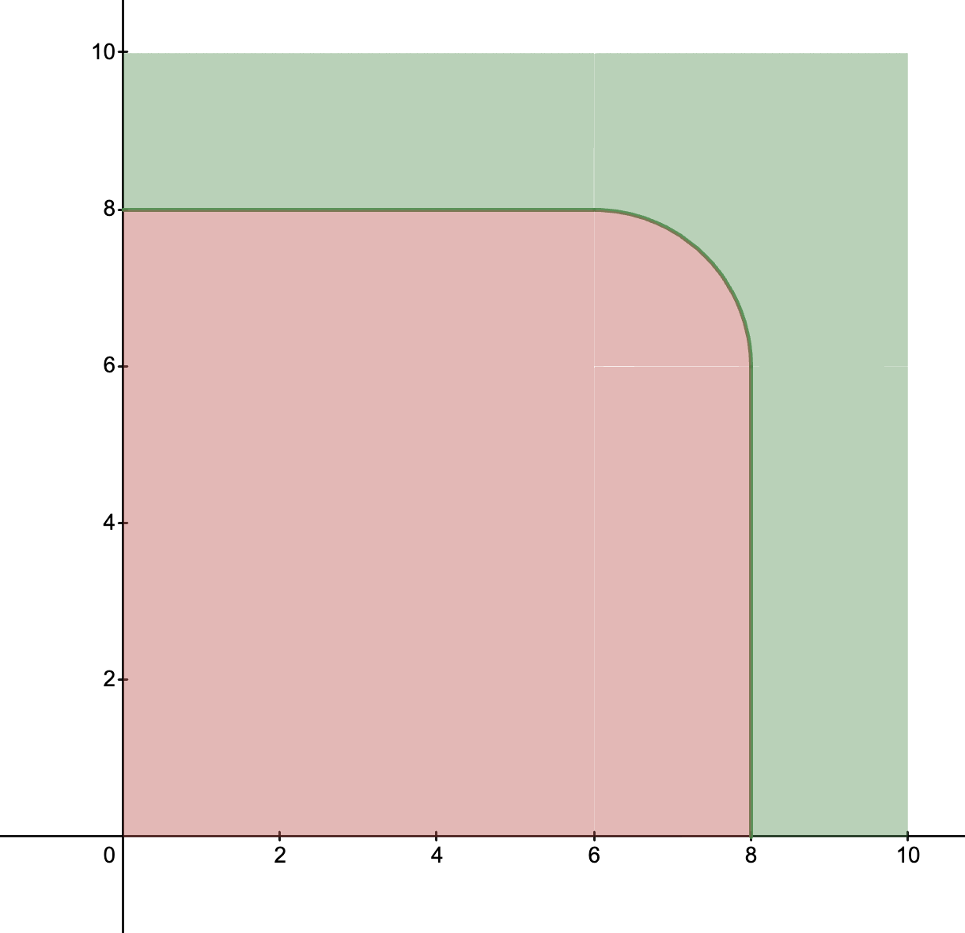
Decision Trees
Can I afford it?
Is it comfortable?
Comfort
Is it fashionable?
Fashion
11
Notes:
Obviously, you want a shoe that you can afford. In this particular case, you want a shoe that is super comfortable and/or super fashionable - you don't want a shoe that is both only kind of comfortable and kind of fashionable. Then if you want to visualize your preference, the graph might look something like this.
Here, we graph possible shoes on fashion level versus comfort. We can see that the green area represents the shoes that we would buy, as they have either a super high fashion level and/or a super high comfort level, and the red area represents the shoes we would not buy.
And as you can see, (click) due to the irregular shape of the graph, a linear model will not work well. This is a situation where the decision tree model will work well.

Slide 12




Decision Trees
Can I afford it?
No
Don’t buy
Yes
Is it super comfortable?
Yes
No
Buy
Is it super fashionable?
Yes
No
Buy
Don’t buy
12
Notes:
This is the decision tree that can be used to represent our graph. Here we have a flowchart of decisions based on our three factors. First, we look at if we can afford it. If not, we immediately don't buy it. If it is affordable, we move on to is it super comfortable. If yes, we buy it, and if no, is it super fashionable. Once again, if yes, we buy it, and if no, we don't buy it.
So, this flowchart of decisions will ensure that we buy a shoe that is affordable, super comfortable and/or super fashionable, just as we required.
TAKE QS
The goal of the decision tree model is to produce this flow chart, and it may generate a tree that looks like this.

Slide 13
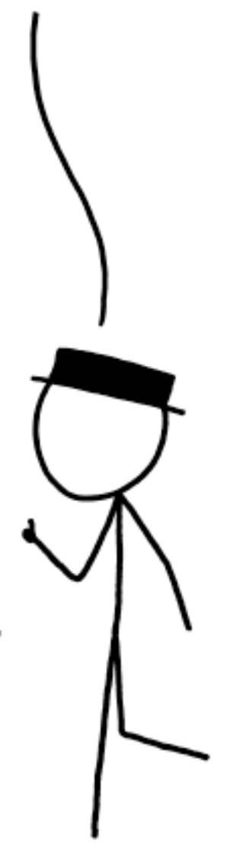
Decision Trees
Price ≤ $100?
No
Don’t buy
that seems awfully hard-coded!
Yes
Comfort ≥ 8?
flowcharts of decisions can create an explainable and repeatable graph of predictions
Yes
No
Buy
Fashion ≥ 8?
Yes
No
Buy
Don’t buy
13
Notes:
In terms of affordability, the rule is that price has to be less than $100. For comfort level and fashion level, at least one of them must be greater than 8.
(click) Once again, the goal of the decision tree model is to produce a flowchart or decision tree that looks like this based on our data.
But this seems quite hard coded. How would a computer figure out how to create this flowchart?

Slide 14
Decision Trees
Price
Comfort
Fashion
Purchased?
$70
4
6
No
$120
5
8
No
$20
4
4
No
$60
1
8
Yes
$60
6
3
No
$80
8
8
Yes
14
Notes:
The model begins with just this raw data. In order to create the decision tree from this data, the model needs to choose decisions based on the features and split the dataset according to the decision.
For example, one possible decision is to split the dataset based on if the price is greater or less than 100. Notice that this split based on the price was the first decision used in the example decision tree.
However, there are other possible splits. Maybe we could split the dataset based on if the price is greater than 60. Or should we start with a split based on the comfort level or fashion level?. But how does the model know which split is the best?

Slide 15
Decision Trees
Purchased?
No
No
No
Yes
No
Yes
15
Notes:
Within this column, let's look at some possible splittings.

Slide 16
Decision Trees
No
Yes
No
No
No
Yes
16
Notes:
Here, we have a possible splitting based on a feature that splits the dataset into two groups: One group with three 'No's, and one group with two 'Yes's and one 'No'. (click)

Slide 17
Decision Trees
No
Yes
No
No
No
Yes
17
Notes:
Let's look at another possible splitting. (click)

Slide 18
Decision Trees
Which one is a better split?
No
No
Yes
No
No
No
No
No
Yes
No
Yes
Yes
All no
Mostly no
18
Notes:
Here, we have two splits. But (click) which one is better?
(TAKE ANSWERS)
The left one is better, but why? (MAY VARY BASED ON ANSWERS)
It's better because we have a group that is all 'No'. (click) Once we make this split, we can immediately say, based on this decision, we know all the shoes that are on one side of the threshold we immediately know we aren't going to buy. Then we can just focus on the other group, and that moves us closer to knowing the threshold.
However, in the other splitting, both groups still have both 'Yes' and 'No'. (click) So this isn't as useful to the model because it still has to make further splits in both groups.

Slide 19
Decision Trees
Gini impurity
Purchased?
Purchased?
No
No
0
No
No
0.38
No
No
Yes
Yes
0.44
No
No
0.5
Yes
Yes
0.44
0.88
as a group becomes more homogeneous, its Gini Impurity decreases.
19
Notes:
We can intuitively tell which splitting is better, but how can the computer quantify this? Well, it can calculate something called the Gini Impurity.
The Gini Impurity is a number between 0 and 1 and it is a measure of how homogeneous a group is, or how much of the group is the same throughout. When a group is more homogenous (the same throughout) its gini impurity is closer to 0, and vice versa.
In this group, with two 'Yes's and one 'No', the Gini Impurity is 0.44. (click) This group is all 'No', so it is completely homogeneous. Groups that are completely the same throughout are an extreme case where the Gini Impurity is 0. (click). For theses two groups, the Gini Impurities are 0.38 and 0.5, respectively. You can see that groups that are more homogeneous such as this one (point) have lower Gini Impurities.
For each of these two splits, the Gini impurity for the whole split is the sum of the Gini impurities for each group in the split.
(click) We can intuitively tell that the model wants a splitting with a lower Gini Impurity, because we want groups that are the same throughout. Remember, we preferred this splitting which had a group with all 'No's. (click)

Slide 20
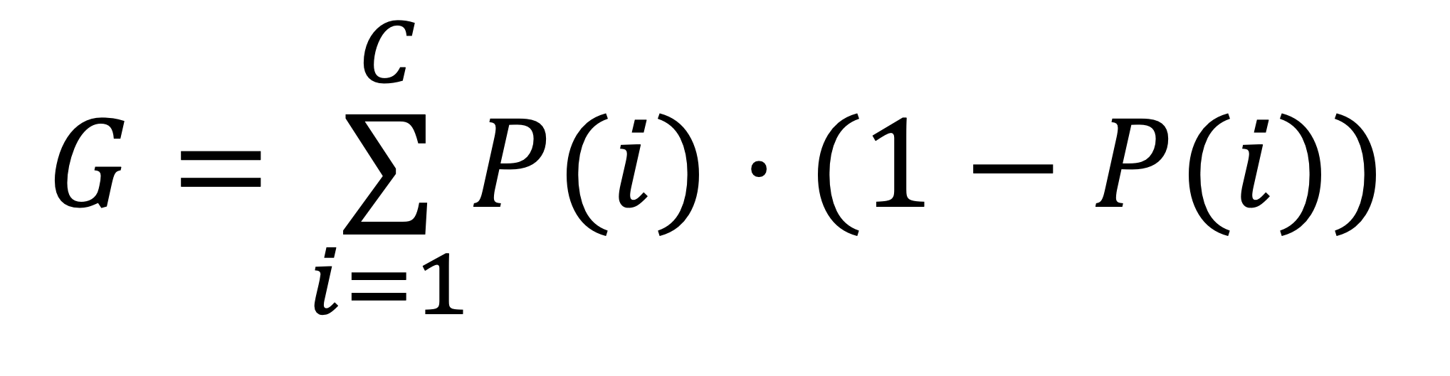
Decision Trees
Gini impurity
Fraction of that one class in group
Fraction of not that one class in the group
$$G=\overset{C}{\underset{i=1}{∑}}P(i)⋅(1−P(i))$$
Add them up for all classes
(in one side of the split)
Gini impurity measures the homogeneity in a group
20
Notes:
This is the formula for calculating the Gini Impurity of a group. The decision tree model will use this formula to calculate the Gini Impurity for possible groups to determine how good a splitting is. For the sake of time, we will not go over this formula in detail, but just know that this is how the model calculates the Gini impurity.
(click through)

Slide 21
Decision Trees
Purchased?
No
0
No
No
Yes
0.5
No
Yes
0.5
21
Notes:
Let’s look back at some possible splittings.

Slide 22
Decision Trees
Purchased?
No
No
0.38
No
Yes
No
0.5
Yes
0.88
22

Slide 23
Decision Trees
we gotta do better than this, right?
Purchased?
No
No
0
No
Yes
No
0.44
Yes
0.44
23
Notes:
We aren’t doing great with these splits (remember that splits are based on the features which may not cooperate)

Slide 24
Decision Trees
Purchased?
No
No
0
just split again!
No
Yes
No
0.44
Yes
0.44
24
Notes:
So we just split again!

Slide 25
Decision Trees
Calculates Gini impurities for ALL possible splits
Select the split that results in the lowest Gini impurity sum
Implements the split
Split again – repeat steps 1-3 as much as needed
a hyperparameter
25
Notes:
So our decision tree algorithm looks like this. First, we calculate the Gini impurities for all possible splits. Every possible threshold for each feature, which in our example is price, comfort level, and fashion level, is a different possible split. For all of these possibilities, we find their Gini impurity.
Next, we select the split that results in the lowest Gini impurity sum, which we know is the optimal split. Then, we use this optimal feature and threshold to implement our first layer of split.
After we make our first split, we simply repeat steps 1-3 for each subgroup: testing out all possible splits and implementing the one that results in the lowest Gini impurity, as much as we need.
That's the basic idea of how a Decision Tree model works. Before I move on to the next model, I just want to point out that while we focused on the Gini Impurity, there are other ways of computing the homogeneity of a group, but they all work in a similar way. Additionally, depending on the data, we can also control how many splits we want the model to do.
TAKE QS

Slide 26
5 ML Models for Classification
1. Decision Tree
2. Random Forest
3. Support Vector Machine (SVM)
4. Naïve Bayes
5. K Nearest Neighbors
26
Notes:
The Decision Tree model is intuitive and can be very useful, but one problem with it is that it is prone to overfitting. We are going to cover overfitting in more detail later, but the basic idea is that the model can fit too closely to the features of the current data such that it fails to generalize on future data.
The next model that we are going to cover is the Random Forest model, which provides a solution to alleviate the problem of overfitting.

Slide 27
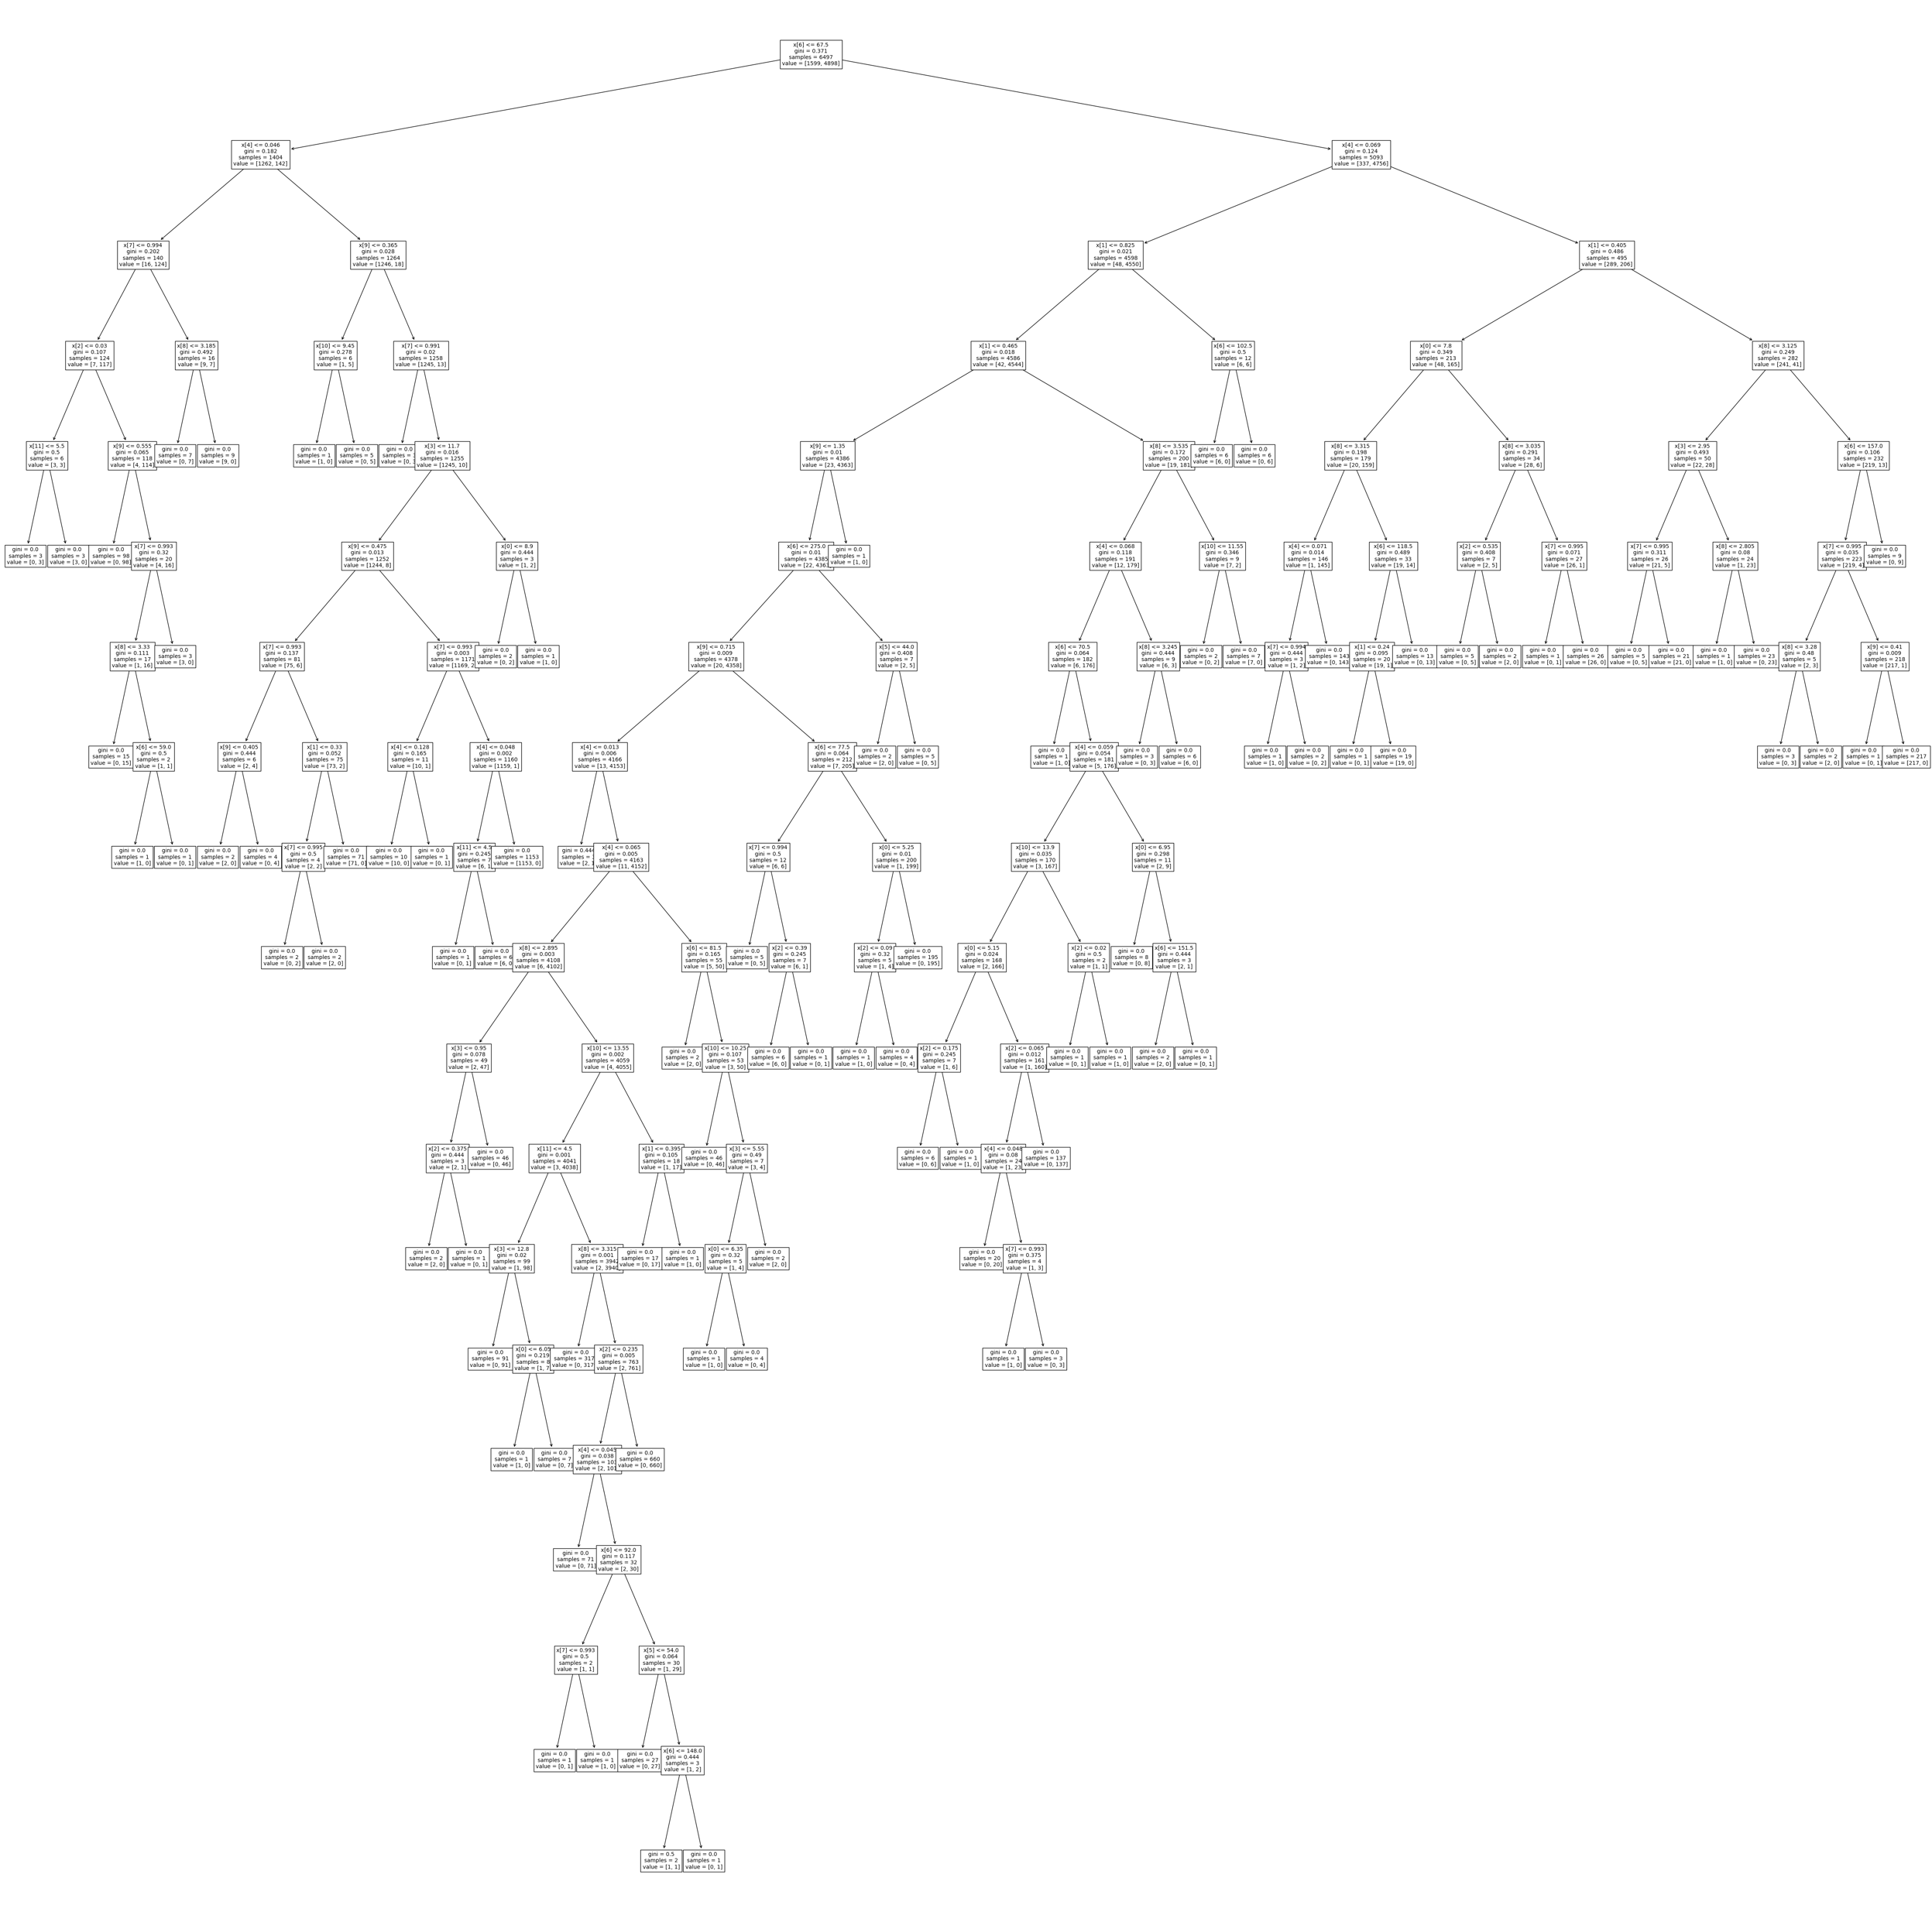
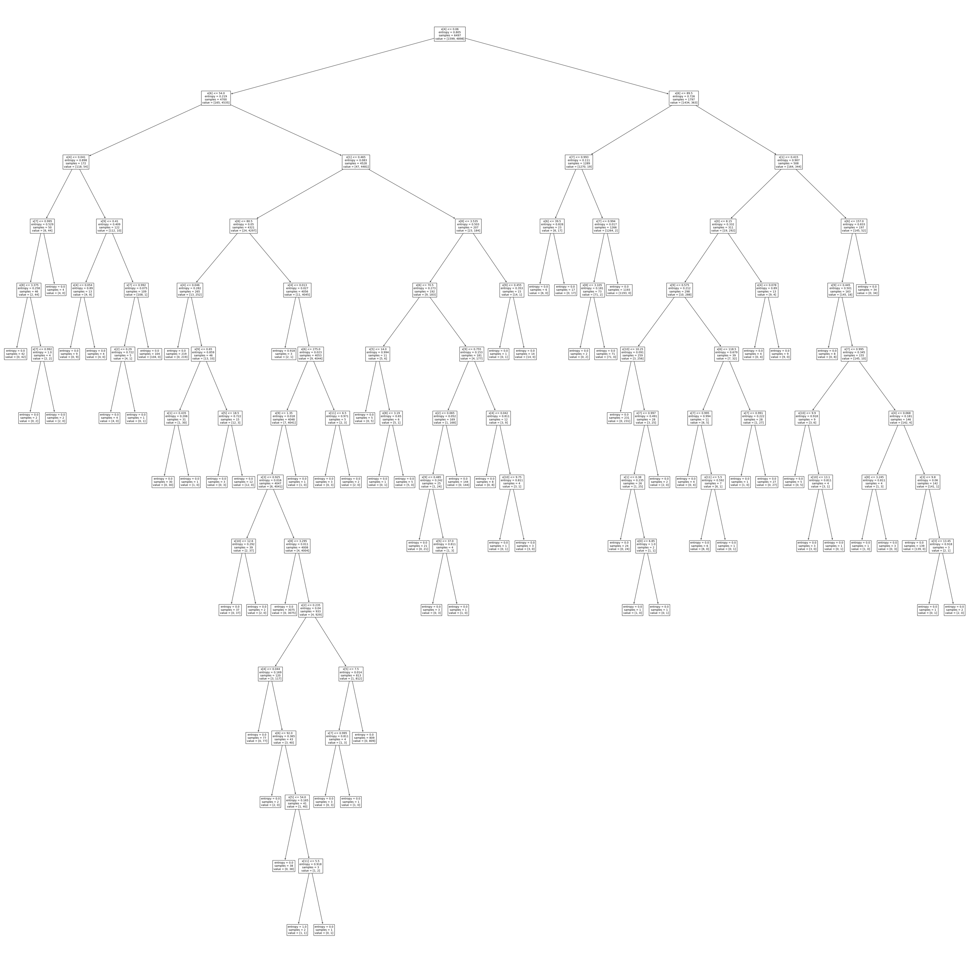
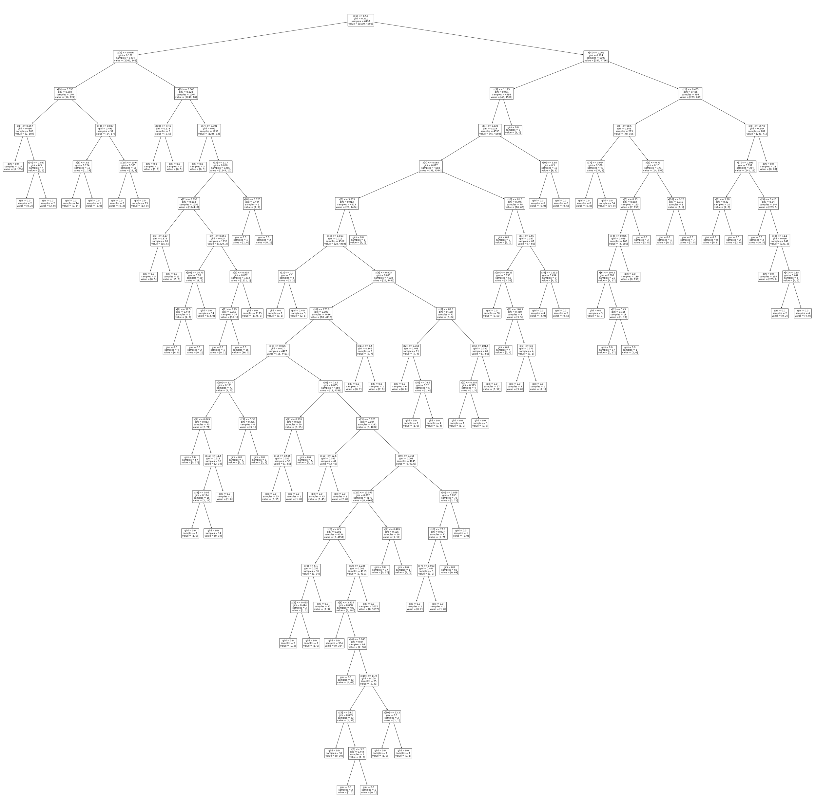
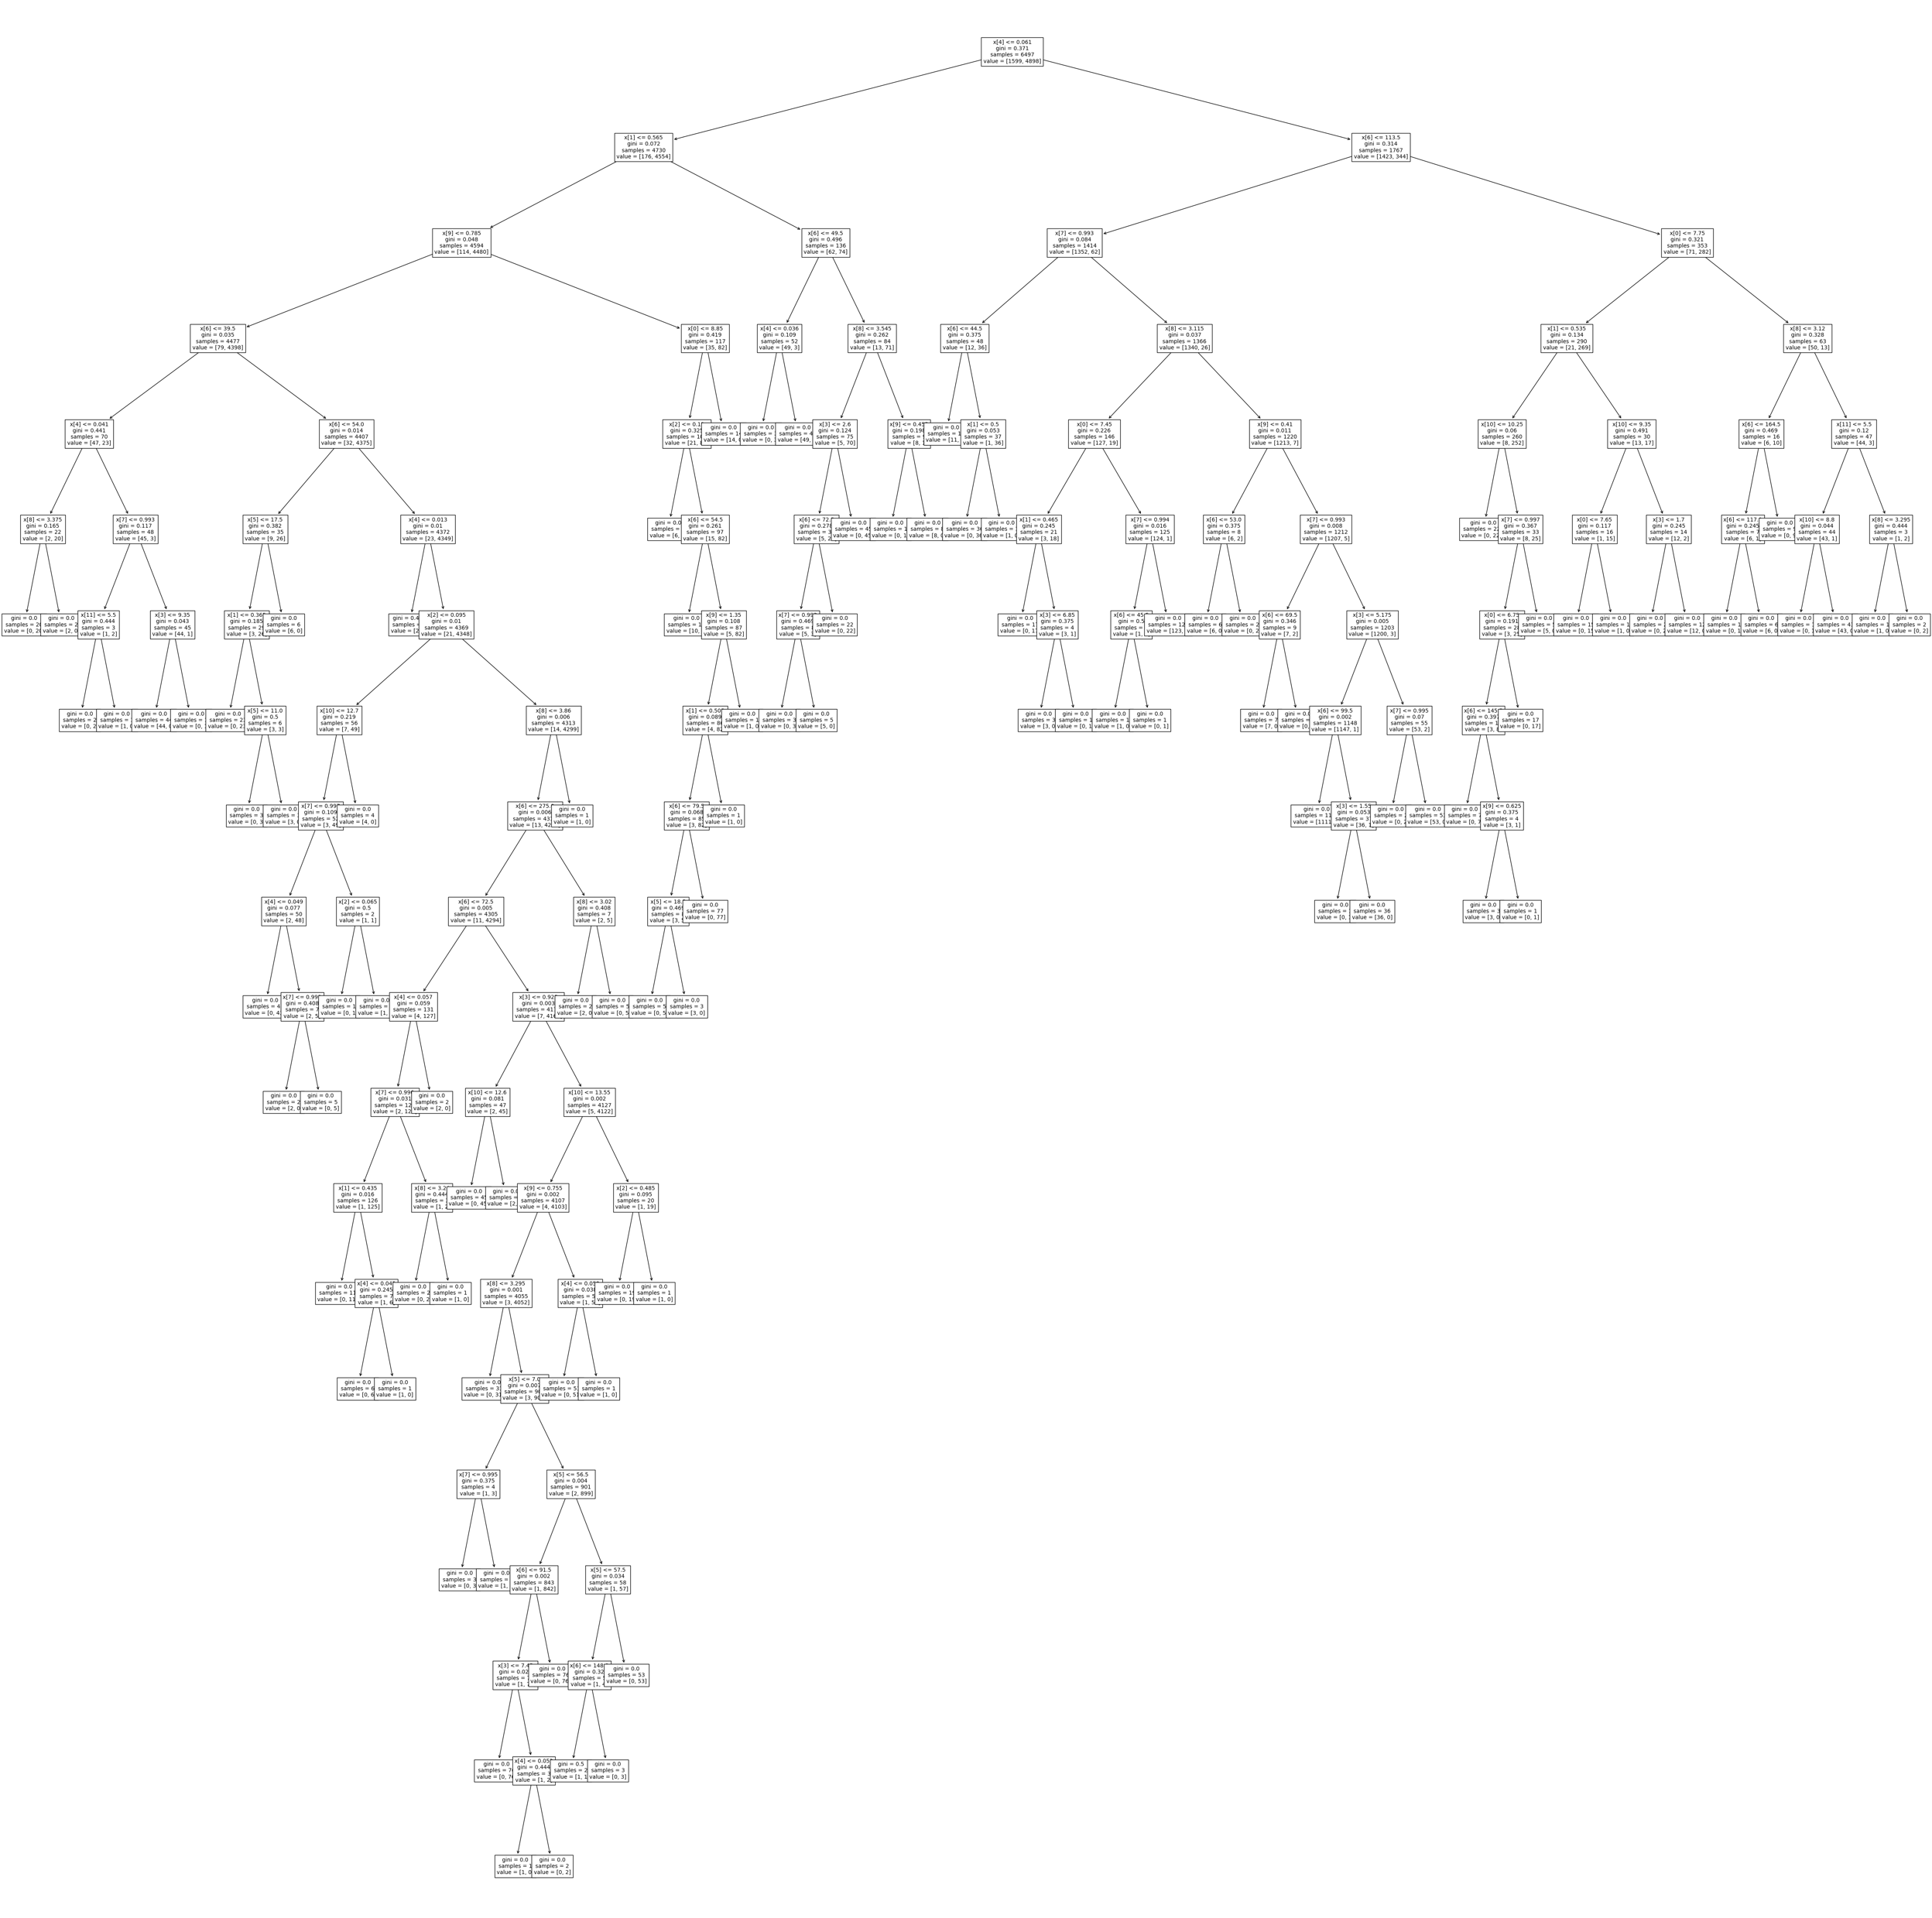
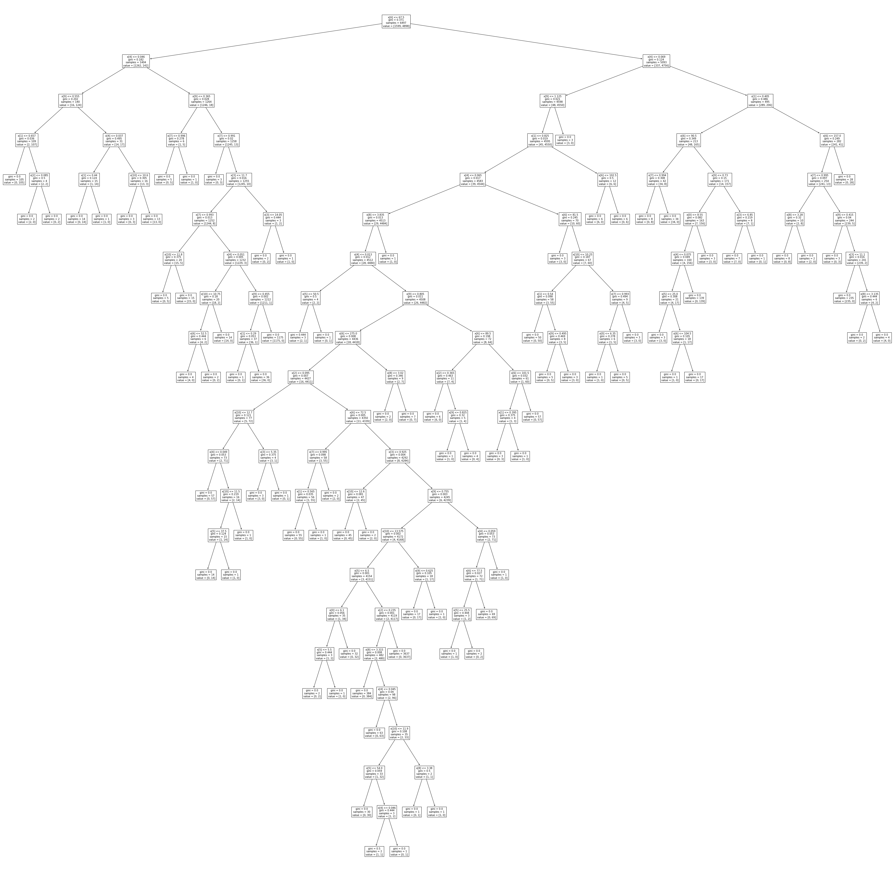
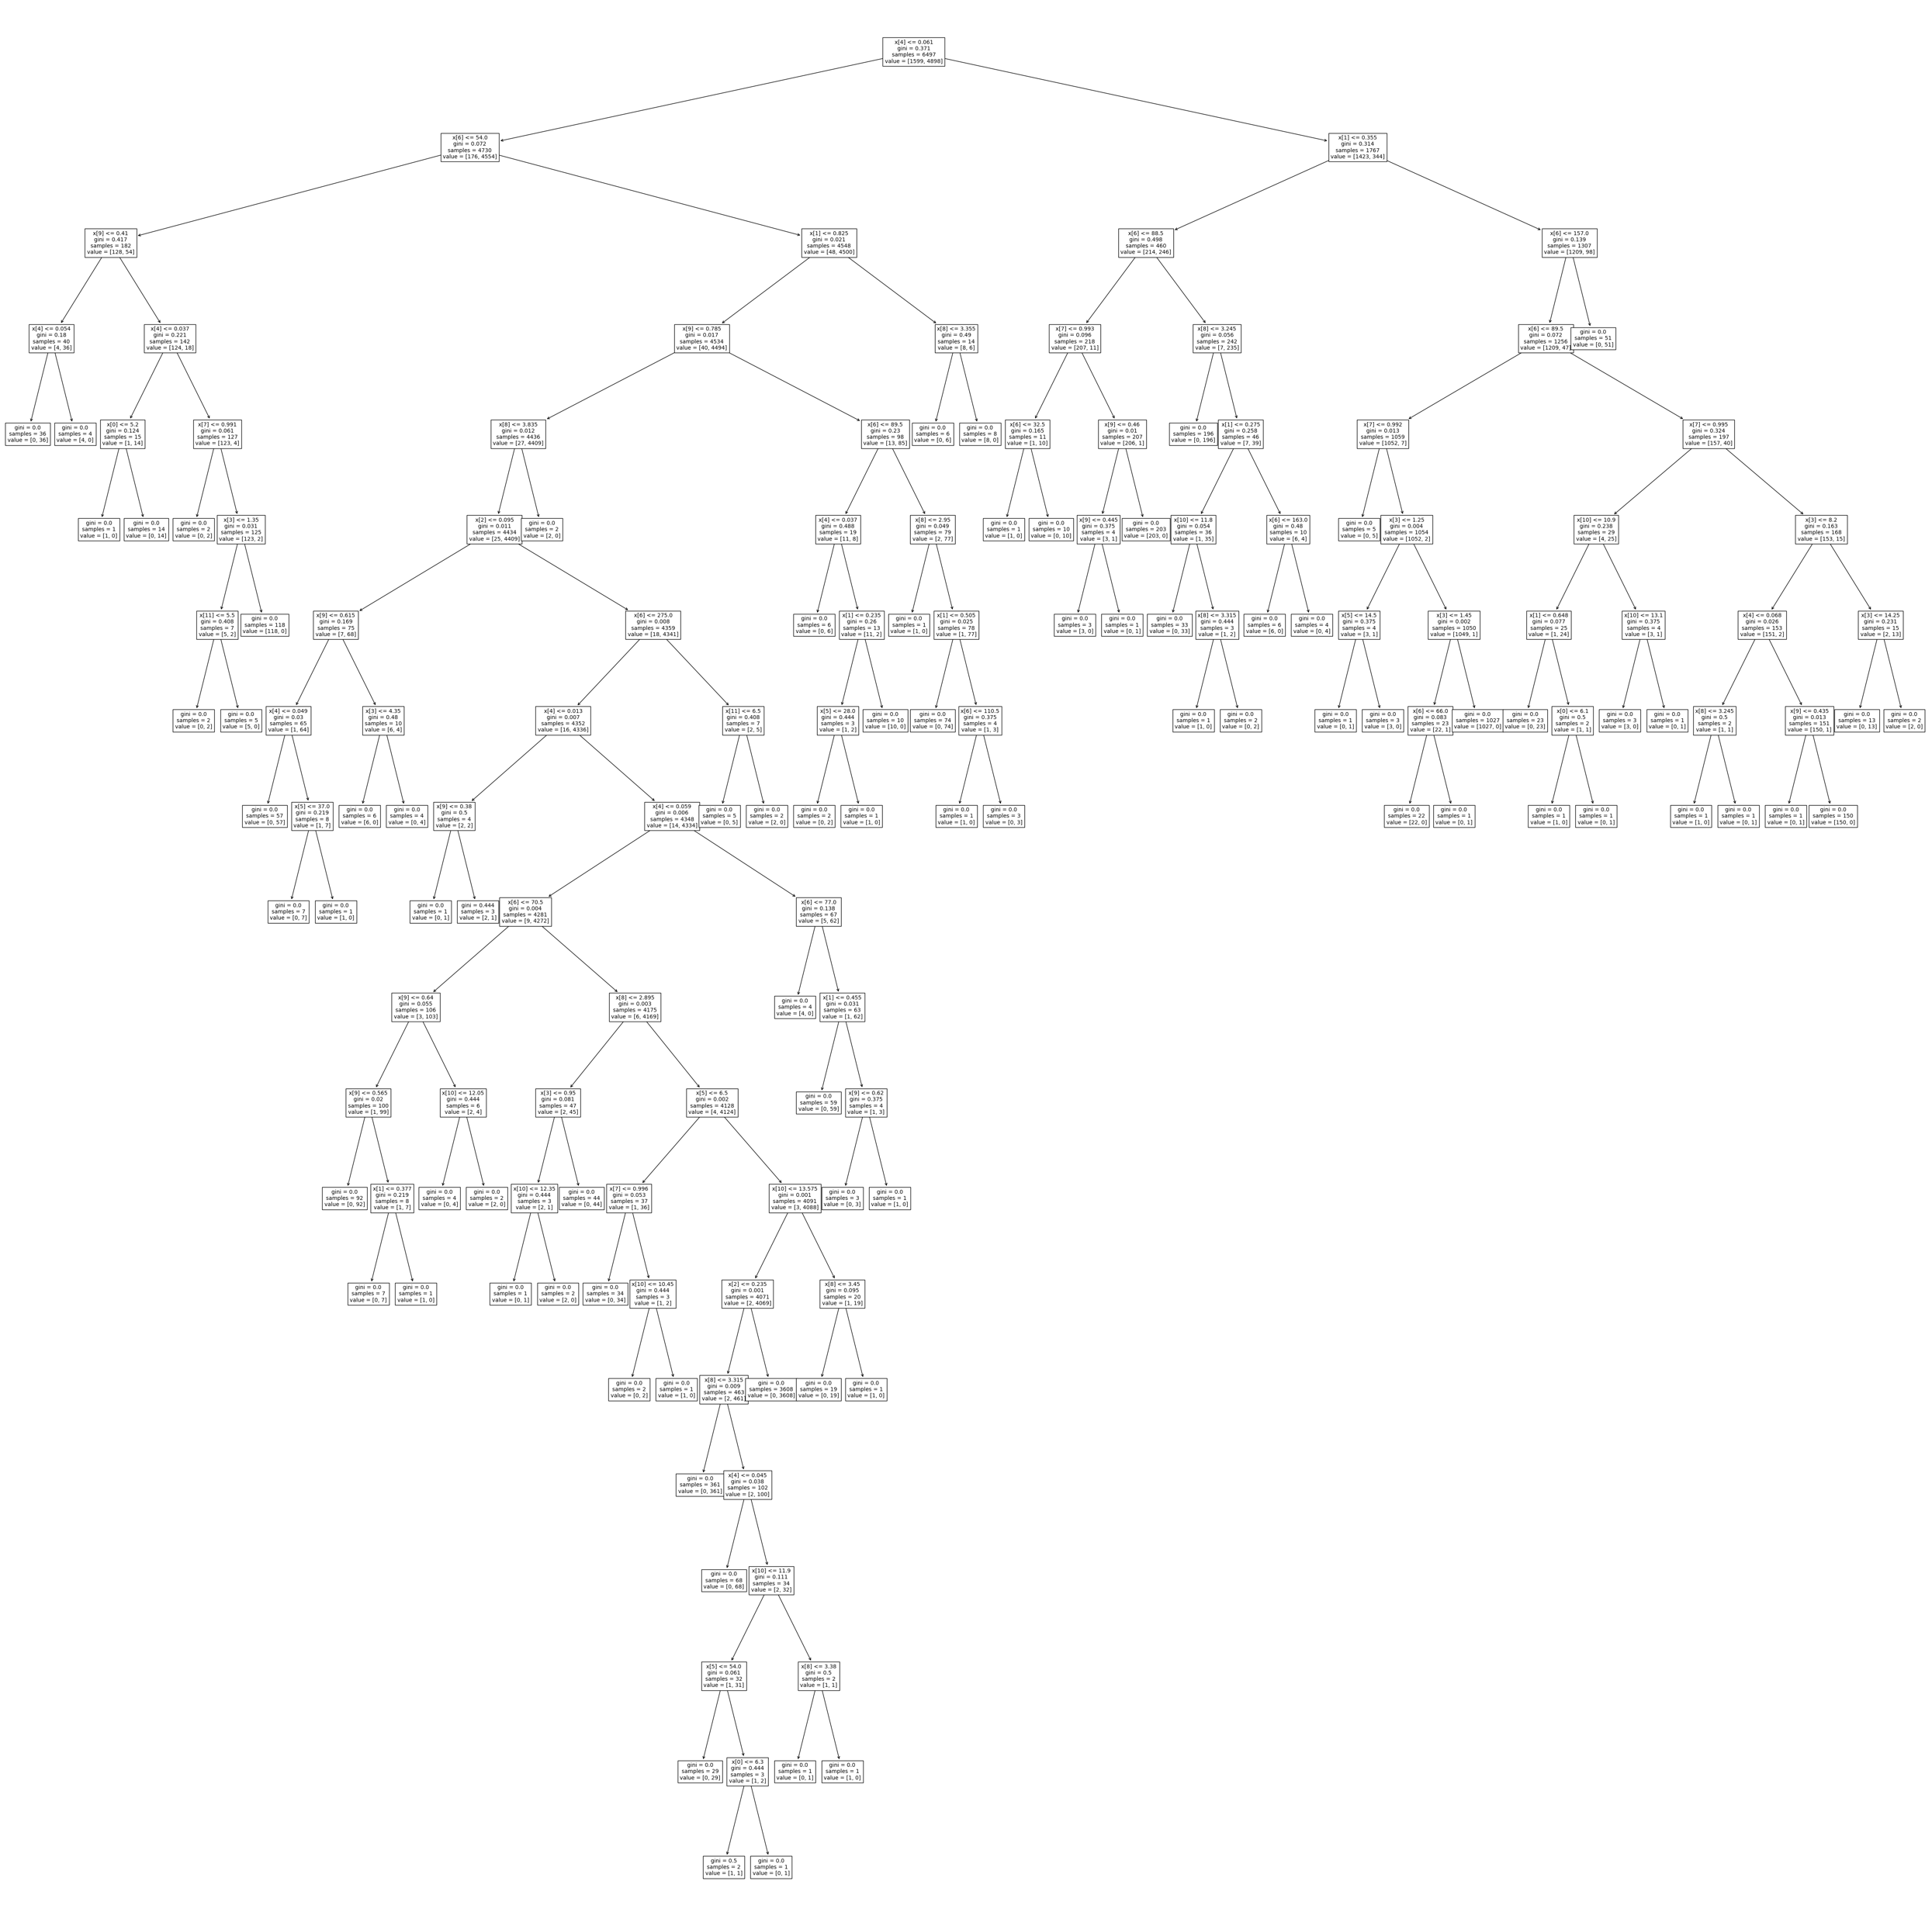
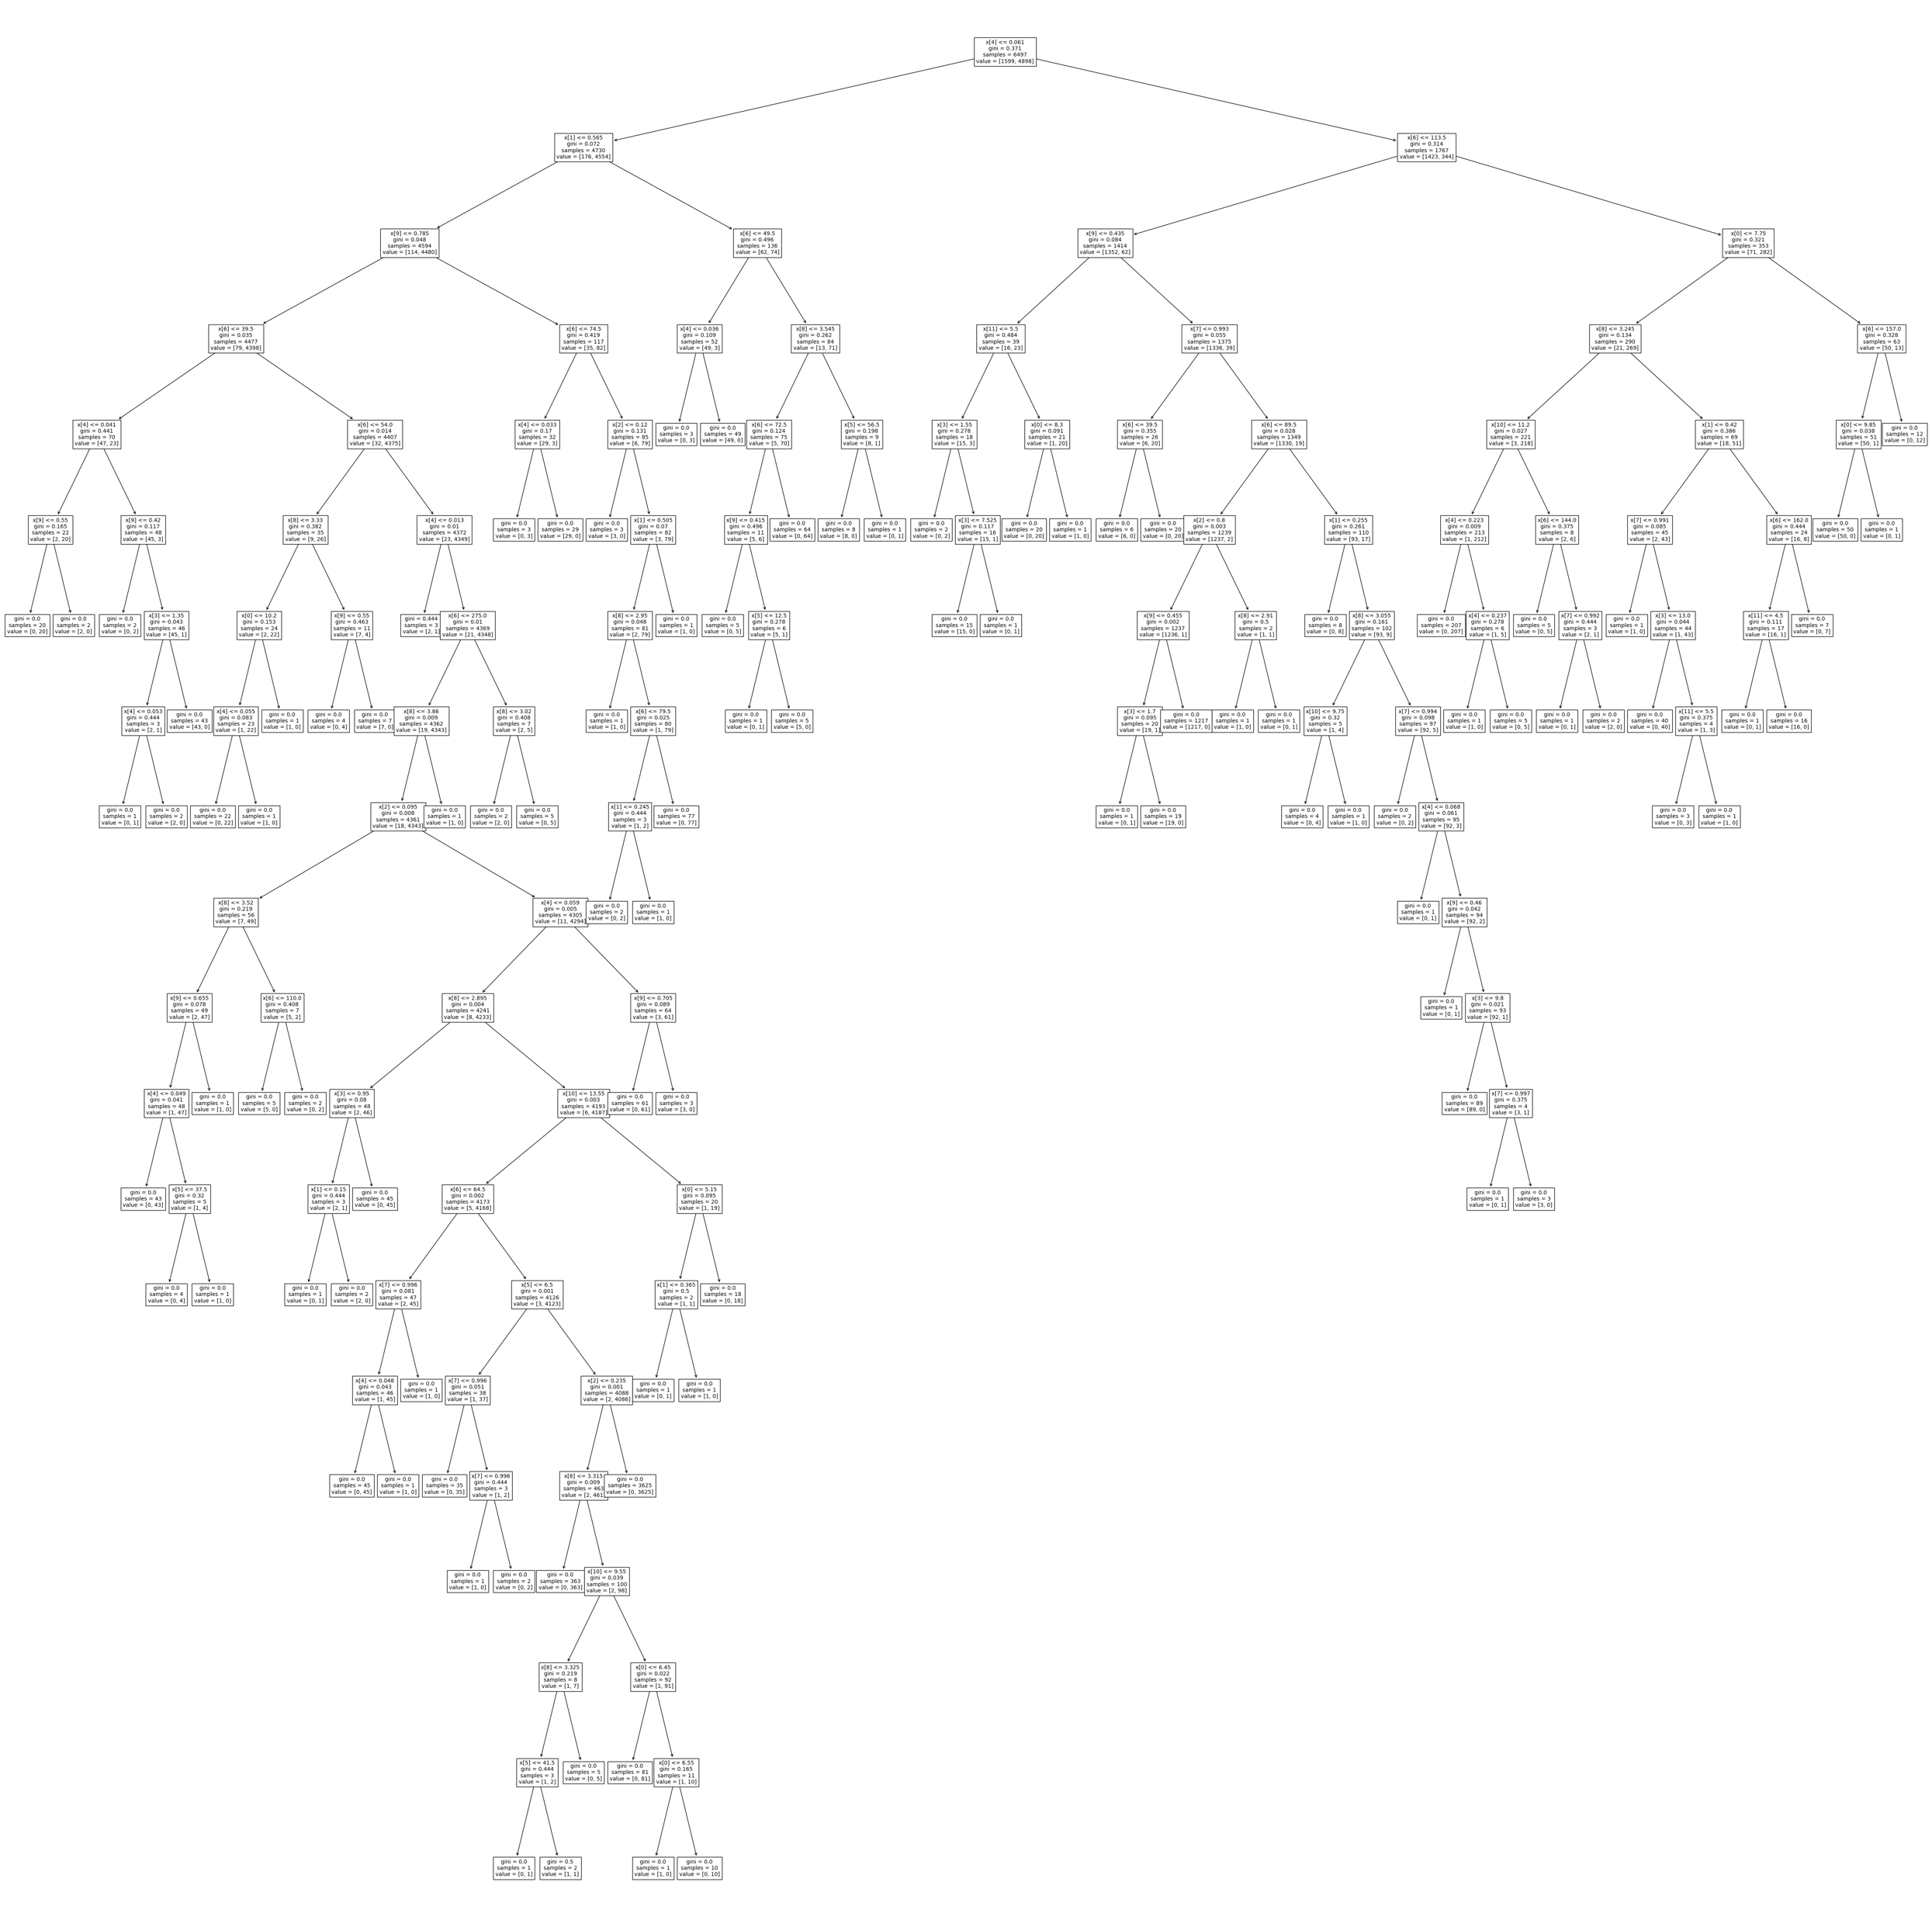
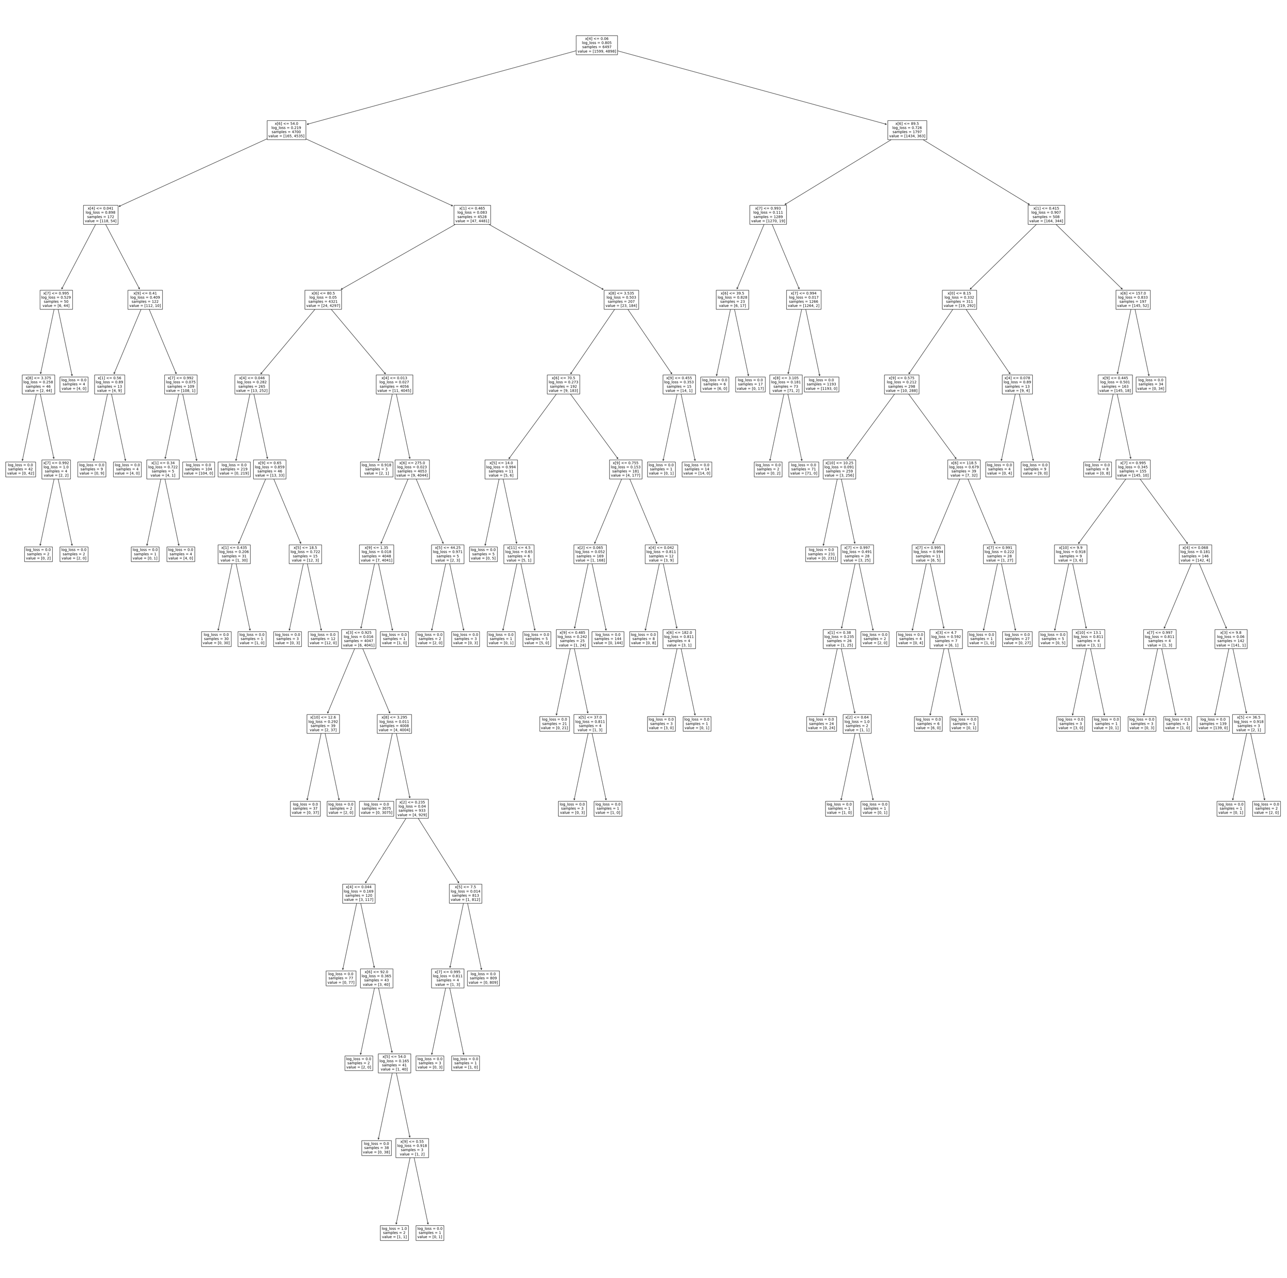
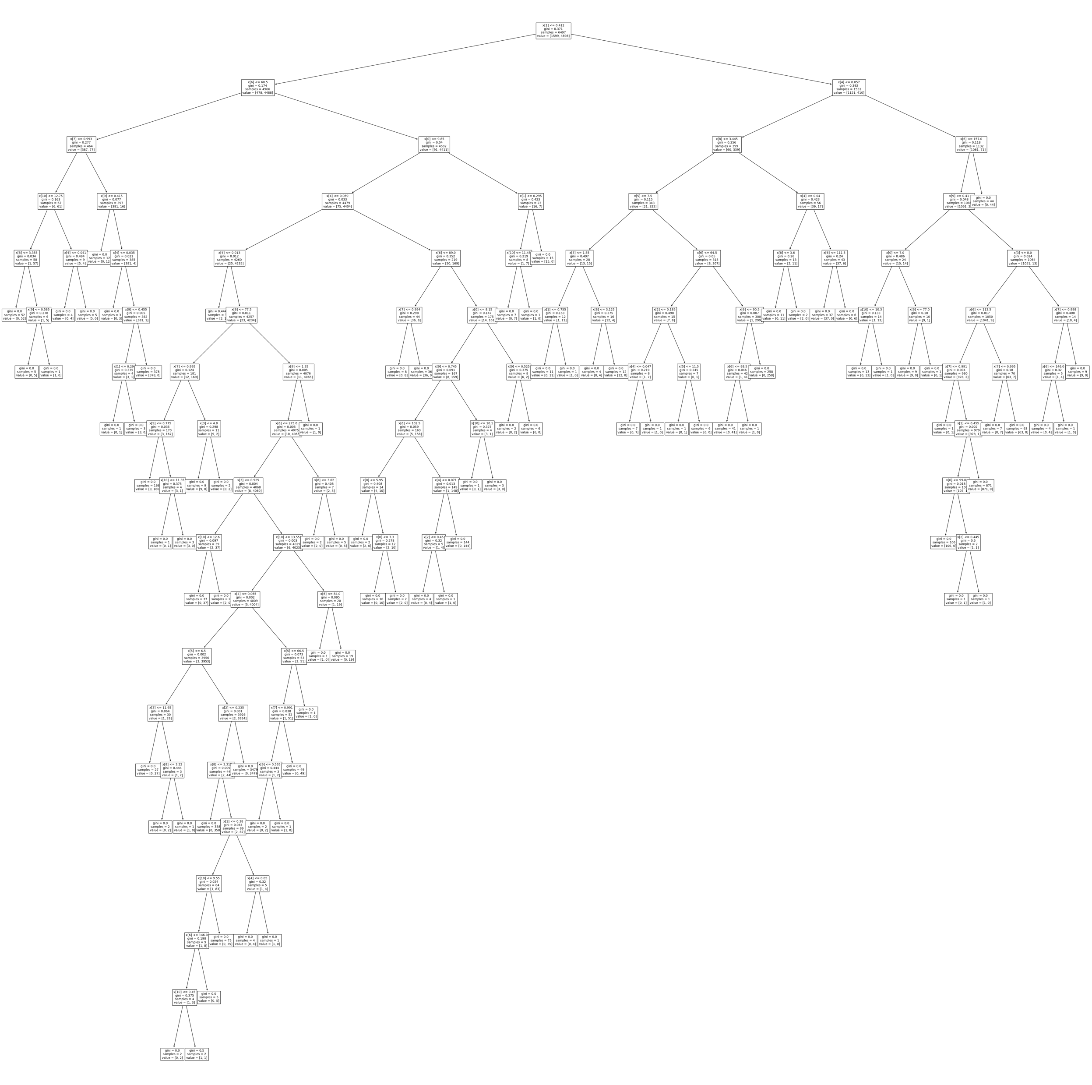
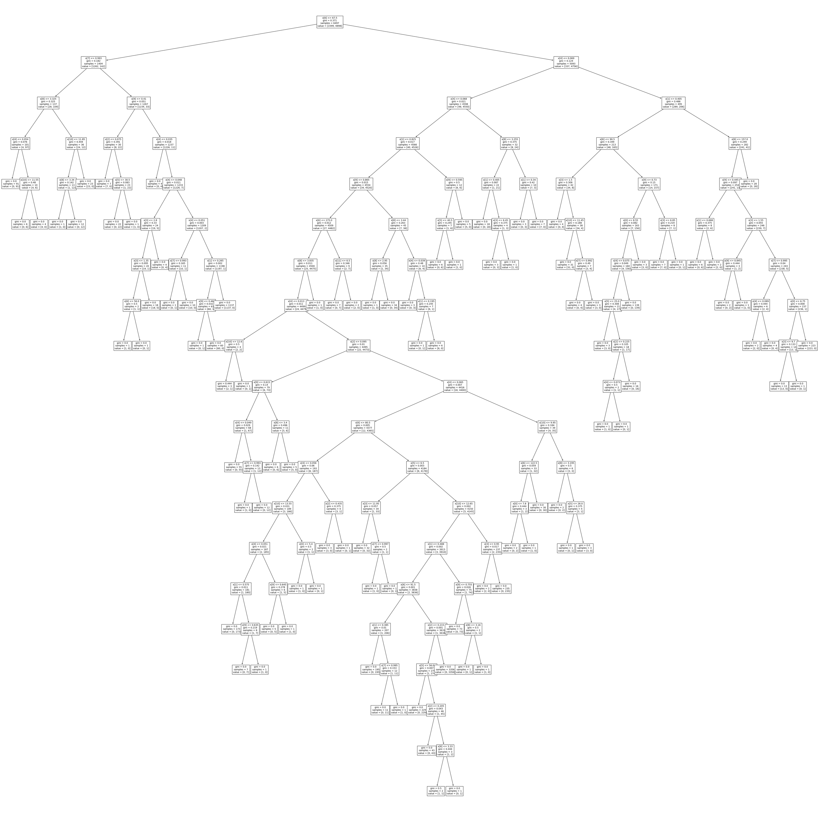
Random Forest
diverse
What if we do it a lot?
27
Notes:
The idea of the Random Forest model is that we can do a lot of decision trees, so many such that we can form a "forest". (click) The reason it's called a "random" forest is that each small tree is trained on a different random part of the dataset. Basically, the model selects a random subset of the data and fits a decision tree to that data, then repeats this process to generate many diverse (click) decision trees.

Slide 28

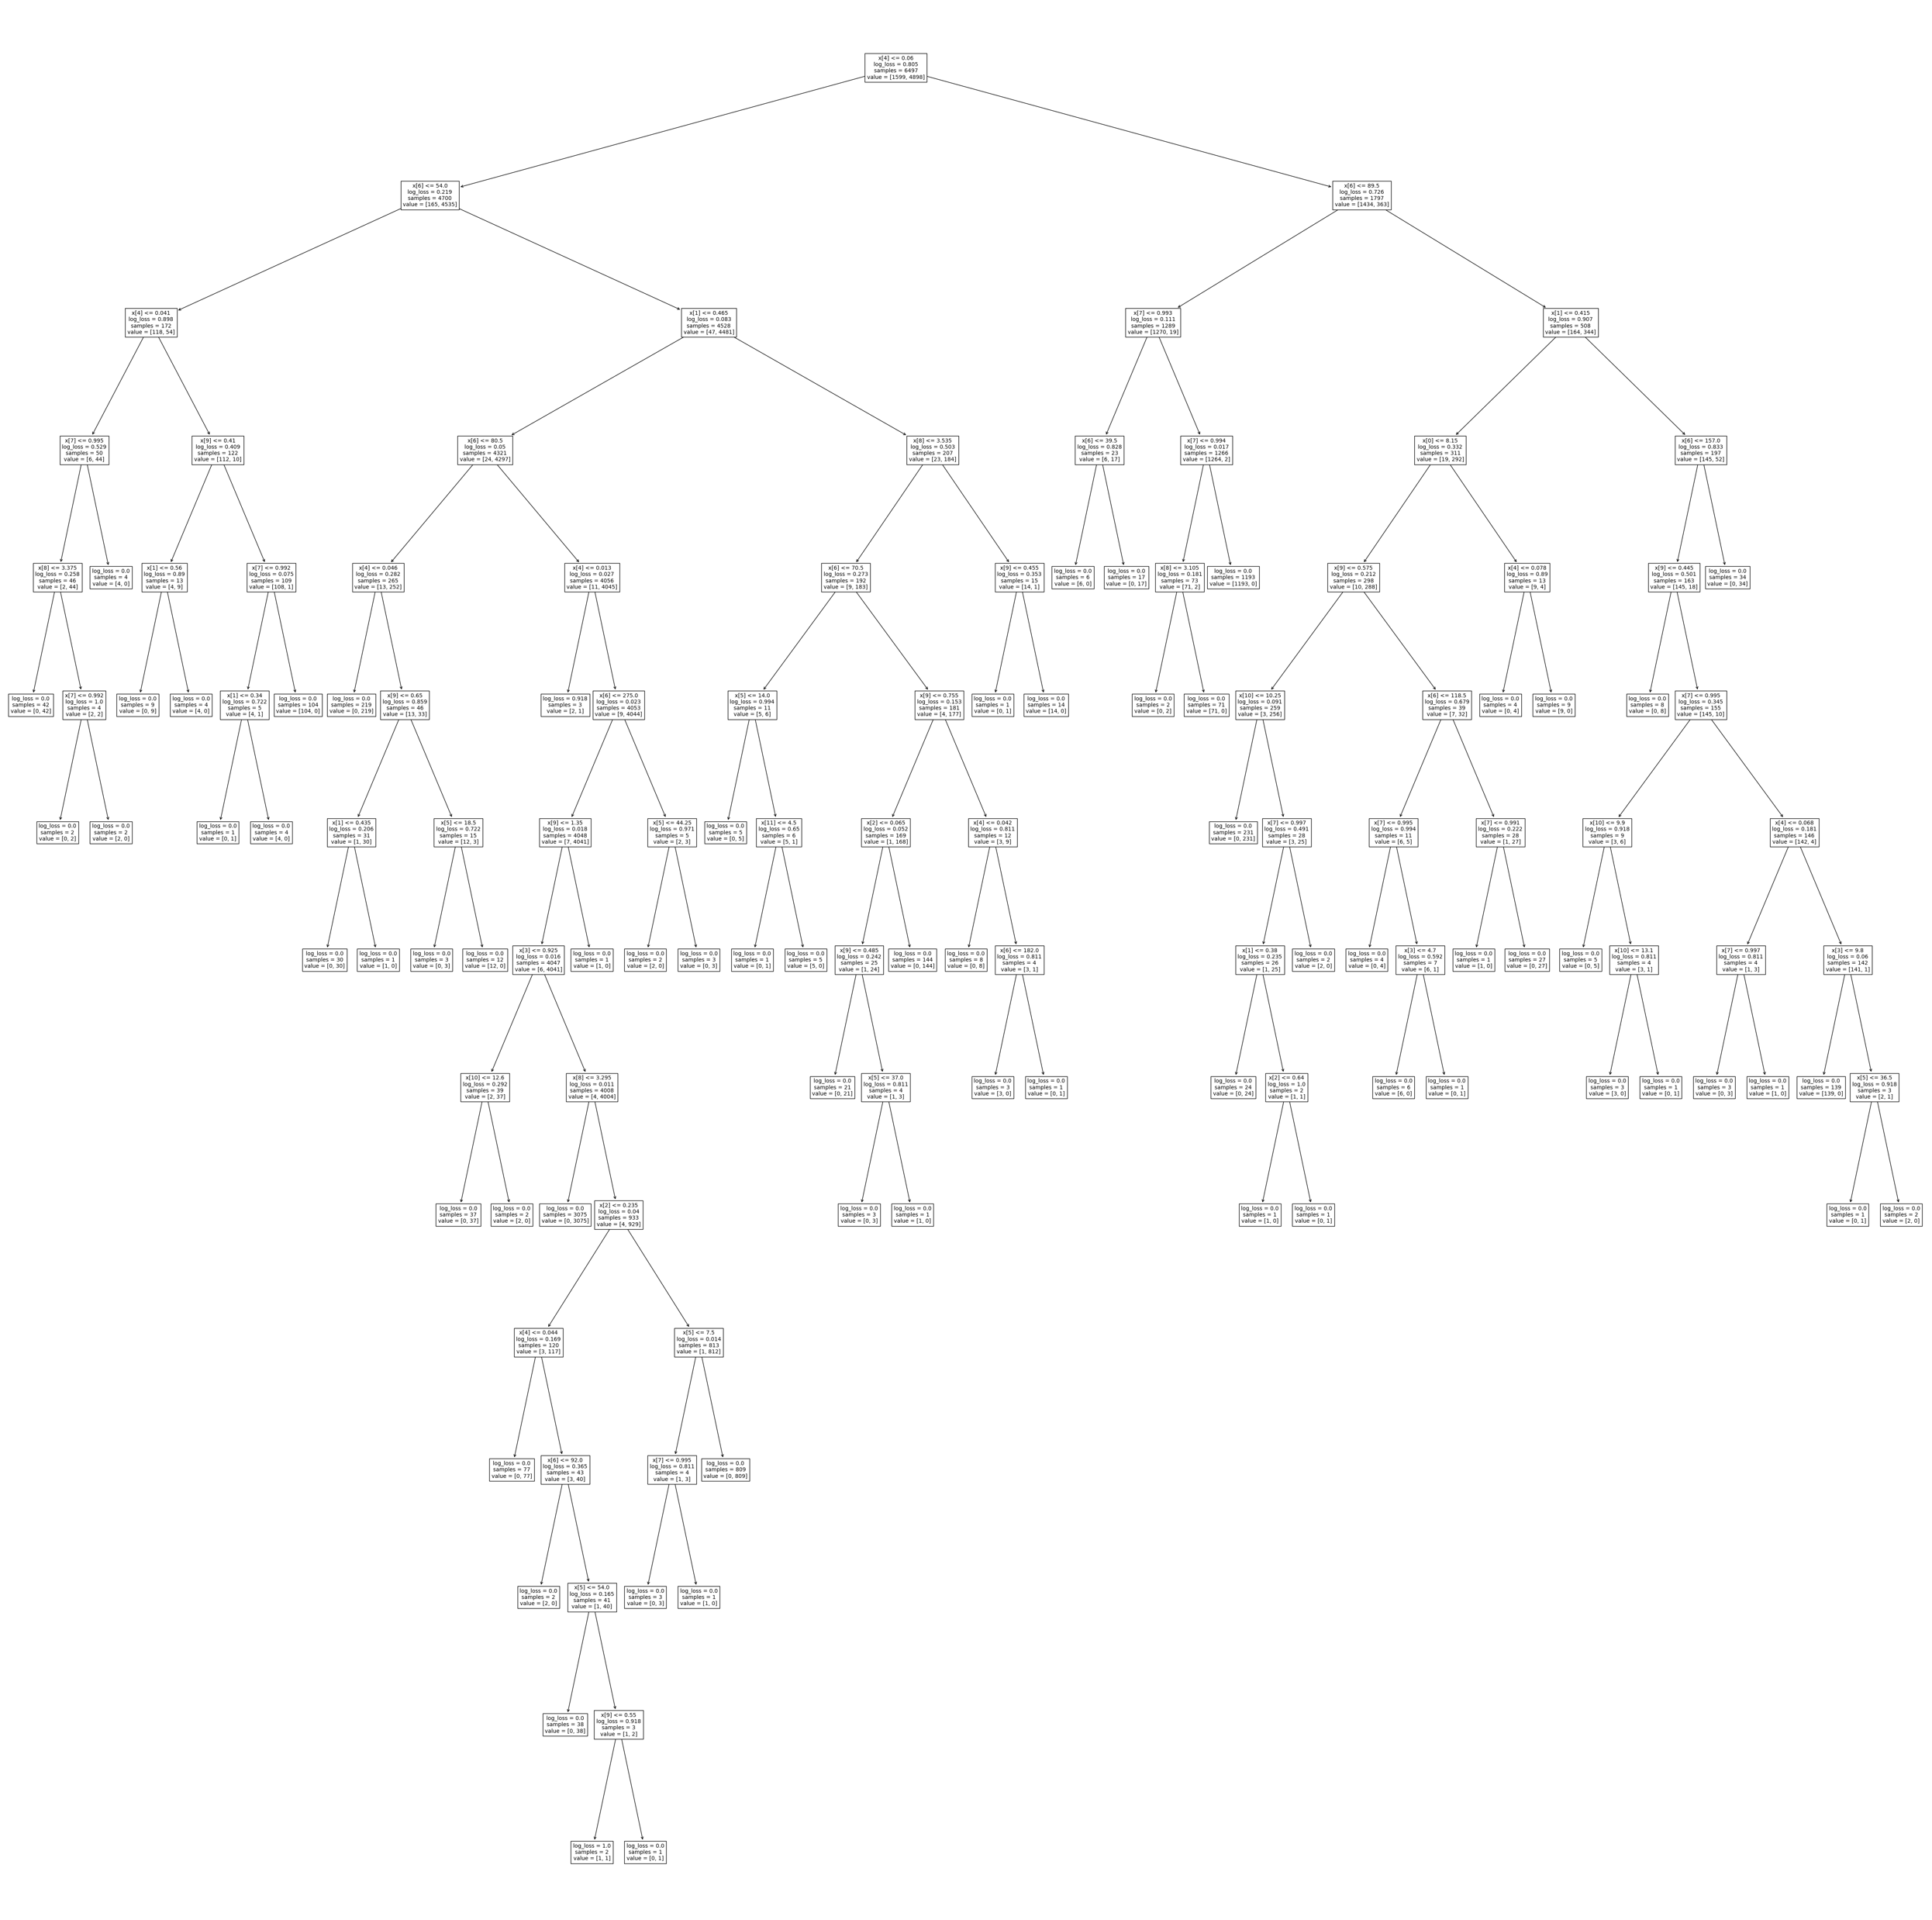





Random Forest
Aye
Nay
Aye
Aye
Nay
Seal of Approval
Council of the Trees
AYE
Aye
Aye
Nay
Aye
Aye
28
Notes:
So we have all these different decision trees. When we want to classify a new datapoint, we simply run it through every single decision tree, (click) and each tree will provide an output which is a class. In this example, the two classes are "Aye" or "Nay". Once we have all of these outputs, we take majority of all the decisions as the final result. In this case, the majority of the decision trees result in Aye', so the final result will be Aye'. (click)
One way to think about why the random forest model works better than decision tree model is to consider the "wisdom of the crowd" idea. This is the idea that large groups of people are collectively smarter than individual experts. Similarly, in this case, each individual small tree may be weaker than the entire decision tree. However, all the small trees collectively will make it less likely that the model overfits to a specific feature of the data, which will make the prediction more accurate.

Slide 29
Random Forest
Make a lot of decision trees, on different portions of the data
For a new sample, run all of them
Combine their votes and take the majority
29
Notes:
Just to recap, this is the general algorithm for the random forest model. First, it creates and trains many small decision trees on different random parts of the data. Next, for a new sample, we will run it through every small decision tree. Finally, we will combine the votes by all the decision trees and take the majority.
When we run the random forest model, we can control the number of decision trees created by the model.
TAKE Qs

Slide 30
5 ML Models for Classification
1. Decision Tree
2. Random Forest
3. Support Vector Machine (SVM)
4. Naïve Bayes
5. K Nearest Neighbors
30
Notes:
Our next model is the Support Vector Machine, or the SVM.

Slide 31
“split”
31
Notes:
To understand the SVM model, let's take a closer look at the idea of a "split".

Slide 32
super
comfortable
Comfort
super
fashionable
“split”
Fashion
32
Notes:
(click) Let's bring back our example about purchasing shoes. Here, we plot multiple shoes based on their fashion level versus comfort level. Remember that we want to buy shoes that are highly comfortable (click) and/or highly comfortable (click). The green points are shoes that we would buy, and the red points are shoes that we would not buy.
Based on the decision tree model, every split of the data was based on a threshold for a single feature. So, if we split the data based the feature of fashion level, the split would look like this.

Slide 33
Comfort
“split”
Fashion
33
Notes:
Here, we can see that if the data is on one side of the threshold for fashion level, it is one one side of the split, and vice versa.
Similarly, if we split the data based on a a threshold for comfort level, the split might look something like this.

Slide 34
Comfort
this is fine, but…
???
“split”
Fashion
34
Notes:
Basically, these two splits are saying that any shoe that falls on this side (point) of these two lines, we would buy it, and if it falls on the other side, we would not buy it.
(click) That's fine, but what if we are considering a shoe that falls right here? (click) In this case, this shoe actually has pretty high comfort and pretty high fashion level, but according to out split, we would not buy it. (click)
In addition, if we look back to our original graph that visualized our preference for shoes, we can see that according to our preference we would actually buy the shoe. Our actual preference is modeled using a curved line, which cannot be represented very well using only horizontal and vertical lines.

Slide 35
Comfort
“split”
Fashion
we need a more complex split
Support vector machines!
35
Notes:
Clearly, we need a more complex split. (click) What if, instead of only using vertical and horizontal lines, we use a slanted line? (click) This is the idea of support vector machines.

Slide 36
Support Vector Machines
Comfort
Fashion
36
Notes:
(click) Here is a possible splitting using a slanted line. As you can see, it accurately splits the red and green points into two groups.

Slide 37
Support Vector Machines
Comfort
Fashion
37
Notes:
This split, on the other hand, does not work.

Slide 38
Support Vector Machines
Comfort
Fashion
38
Notes:
Neither does this one.

Slide 39
Support Vector Machines
Comfort
Fashion
39
Notes:
So, how does the computer determine the best line?

Slide 40

Comfort
the “closest” points in different samples
40
Fashion
Notes:
Let's take a look at the points that are closest to the border. (click) These points are, intuitively, the most dangerous points because they can easily be misclassified.

Slide 41
Comfort
41
Fashion
Notes:
(click)

Slide 42
Comfort
42
Fashion
Notes:
Even if the split moves slightly up or down, it runs the risk of misclassifying these borderline points. (click)

Slide 43
Comfort
43
Fashion
Notes:
(click)

Slide 44
Comfort
We gotta do better than this!
a good split maximizes distance between the split line and samples
$$max⁡(min(\text{distance} \text{to} \text{line},\text{over} \text{all} \text{points}))$$
We want to make this big!
44
Fashion
Notes:
To make the best split, we want our line as far away from the border points as possible. (click) So we want it to maximize the minimum distance between the line and the points. (click)
So out of all these distances from the points to the line, (click) we focus on the points with the minimum distance (point) and we try to maximize these distances. (click)
The split we have here is very close the the border points. (click) Can we do better than this?

Slide 45
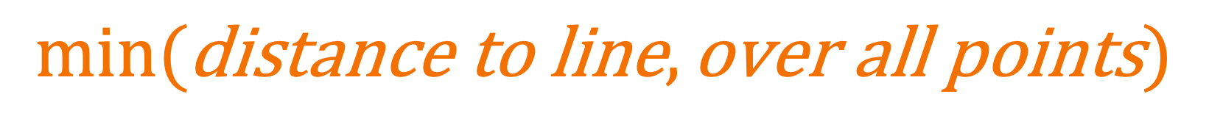
Support Vector Machines
Comfort
$$min(\text{distance} \text{to} \text{line},\text{over} \text{all} \text{points})$$
We want to make this big!
Fashion
45
Notes:
What if we took this line and (CLICK) bent it

Slide 46
Support Vector Machines
Comfort
even better!
$$min(\text{distance} \text{to} \text{line},\text{over} \text{all} \text{points})$$
We want to make this big!
Fashion
46
Notes:
This curved line is even better! (click) It's not really close to any points, which makes it a much more stable split. The job of the SVMs (support vector machines) is to help us find this best split.

Slide 47
Support Vector Machines
Comfort
even better!
$$min(\text{distance} \text{to} \text{line},\text{over} \text{all} \text{points})$$
We want to make this big!
support-vector machines are classifiers that divide data by class, aiming to create a margin that’s as wide as possible.
They can use non-linear functions
Fashion
47
Notes:
Sometimes the best split is a linear line, and sometimes it is not. (click) In those cases, the SVM uses non-linear functions such as polynomial or exponential functions to find the best split. In this respect, the SVM is very flexible.
In regards to our original preference, (click) which we can consider as the ground truth, we can see the curved line that the SVM comes up with is actually quite accurate.
TAKE Qs

Slide 48
5 ML Models for Classification
1. Decision Tree
2. Random Forest
3. Support Vector Machine (SVM)
4. Naïve Bayes
5. K Nearest Neighbors
48
Notes:
Let's move on to our next model: the Naïve Bayes model.

Slide 49
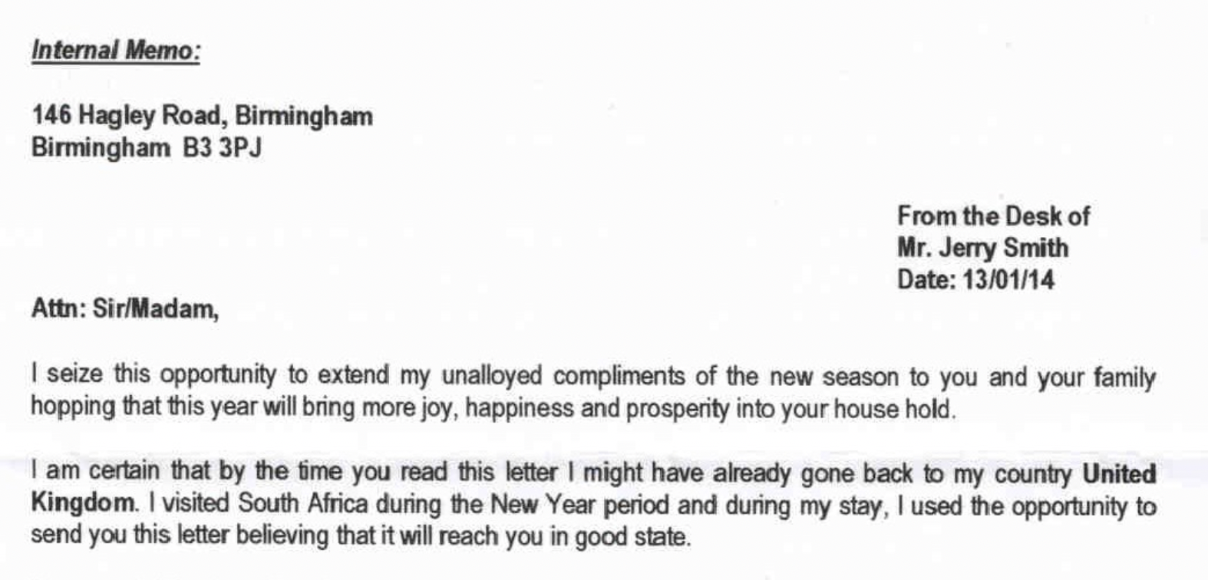
49
Notes:
For this model, let's use a new example. (click) Let’s say you have an email and you’re trying to detect if it’s spam or not.
*read aloud
Who thinks this is a spam email?

Slide 50

“unalloyed complements”
Spam
“$100,000 dollars”
Spam
“relative dying of cancer”
Spam
50
Notes:
It is pretty obvious that this email is a spam email. If you are looking for a specifc giveaway that this email is spam, one highly suspicious phrase might be (click) "unalloyed complements", because nobody uses this phrase in real life.
What are some other phrases which may be associated with spam emails?
Some more examples of spam-suspicious phrases are (click) "100,000 dollars" or (click) "relative dying of cancer".

Slide 51
IF we have this
we get this
“unalloyed complements”
Spam
“$100,000 dollars”
Spam
“relative dying of cancer”
Spam
51
Notes:
If we are trying to determine whether an email is a spam email, we may look for these certain suspicious phrases. That is, (click) IF we have these suspicious phrases, (click) THEN we decide that it is a spam email.

Slide 52
we get this
IF we have this
52
Notes:
Let's focus more on the idea of we get THIS, IF we have this.

Slide 53
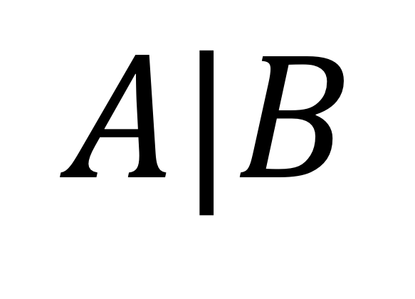
we get this
IF we have this
$$A|B$$
53
Notes:
We can use this notation to represent the idea: (click)

Slide 54
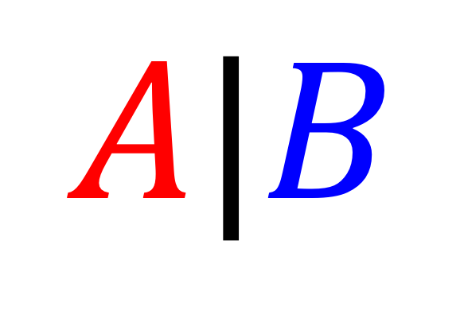
we get this
IF we have this
$$A|B$$
Is Spam
“Nigerian Prince”
54
Notes:
We get A IF we have B. In our particular example, A represents a spam email, and B represents a suspicious phrase. That is, we get a spam email (click), if we have a suspicious phrase - let's say the phrase is "nigerian prince".

Slide 55
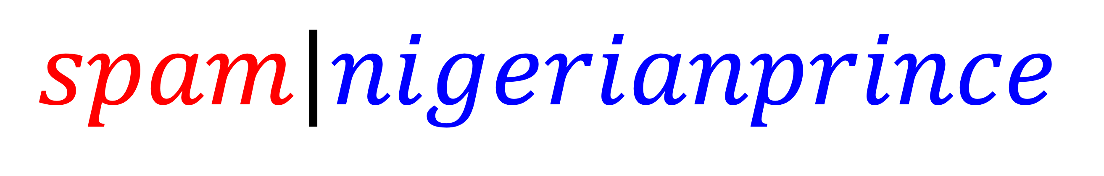
we get this
IF we have this
$$spam|nigerianprince$$
55
Notes:
We have spam IF we have nigerian prince.

Slide 56

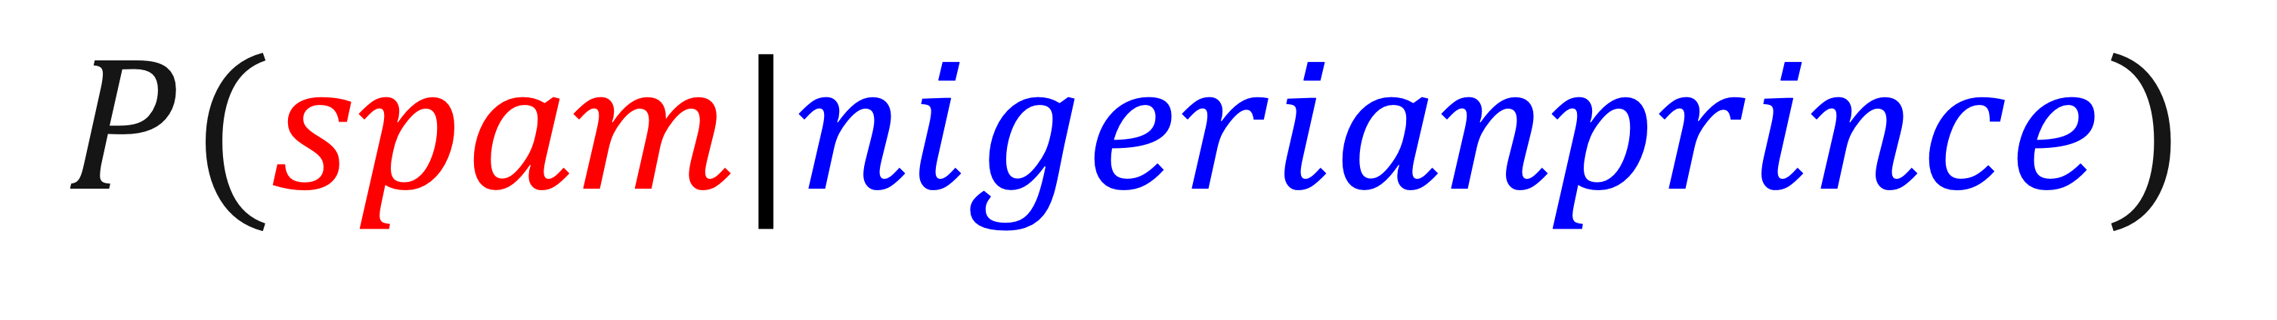
we get this
IF we have this
$$P(spam|nigerianprince)$$
high?
Nigerian prince
spam likely
low?
Nigerian prince
not spam
conditional probabilities can be used as a classifier!
56
Notes:
Realistically speaking, if an email contains the phrase "nigerian prince", it won't always be a spam email 100% of the time. That's why we instead consider the probability that an email is spam given that it contains "nigerian prince". This is called a conditional probability - a probability based on a given condition.
This is also how we will end up doing the classification. If we have a high probability of spam given nigerian prince, (click) then we can classify the email into spam. (click) Similarly, if we get a low probability, (click) we can classify the email into not spam. (click) This is how conditional probabilities can be used as a classifier.

Slide 57



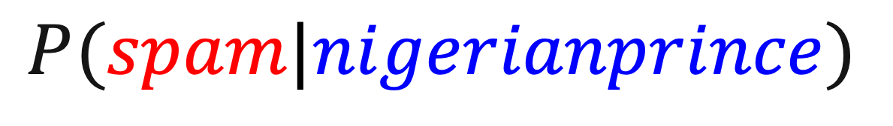
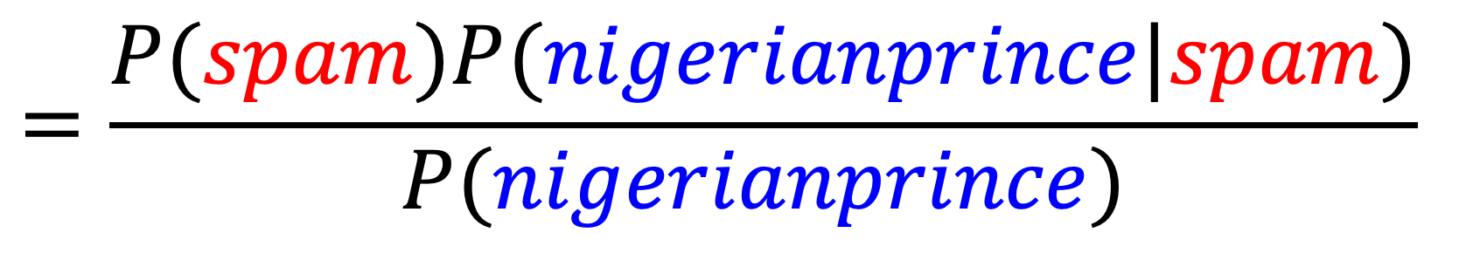
Naïve Bayes
% of spam in dataset that relates to Nigerian prince
Bayes Equation
% of spam in dataset
$$=\frac{P(spam)P(nigerianprince|spam)}{P(nigerianprince)}$$
$$P(spam|nigerianprince)$$
% of Nigerian prince in dataset
57
Notes:
This is the formula to calculate our desired probability. Before I explain this, let's take a step back. We have a dataset of emails. Within this dataset, some of the emails are spam emails, and we know which ones. Some of the emails contain "nigerian prince", and we also know which ones. Then we can use this formula to calculate the probability that an email in this dataset is spam given that it contains "nigerian prince".
It is equal to the probability that an email is spam, (click) which is equal to the percent of spam in the dataset, multiplied by the probability that a spam email contains "nigerian prince", (click) which is the percent of spam in the dataset that relates to Nigerian prince, then divided by the probability that an email contains "nigerian prince" (click), which is the percent of "nigerian prince" - containing emails.
All the values on the right side of the equation are directly observable in the dataset. (click) This equation is called the Bayes Equation, which is the basis of the Naïve Bayes model. The idea of this model is to calculate the probability that we want given probabilities that we already know.

Slide 58
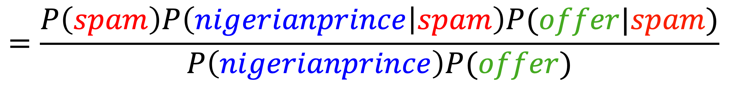
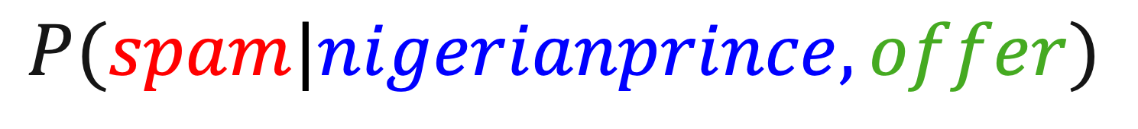
Naïve Bayes
Classifier
$$=\frac{P\left(spam\right)P\left(nigerianprince | spam\right)P(offer|spam)}{P\left(nigerianprince\right)P(offer)}$$
$$P(spam|nigerianprince,offer)$$
conditional probabilities can be used as a classifier!
a classifier made this way, however, is “naïve” when extended to multiple features
multiplication for AND assumes independence!
“naïve”
58
Notes:
This idea becomes even more useful when we want to calculate more complicated probabilities. Here, we have multiple conditions involved: We want to find the probability that an email is spam given that it contains "nigerian prince" AND "offer", which is another phrase that is suspicious.
Well, the probability of spam given these two things is equal to the probability of spam, multiplied by the probability of these two things given spam, divided by the probability of these two things. And if we want the probability that these two conditions are true, we just multiply the probabilities for each condition. (click) *read formula
(click) This is the Naïve Bayes classifier. Once again, these conditional probabilities can be used as classifiers because they are basically telling you how likely a certain result is, so you would classify a sample as that result if the calculated probability is high enough.
(click) One important thing to notice is that this equation assumes that the probabilities are independent. This is why It’s naïve: because in real scenarios, the features may not be mutually independent.
I will talk more about this independence assumption problem in a bit, but first I will briefly go over the general Naïve Bayes Algorithm.

Slide 59
Naïve Bayes
For each feature, calculate the probability of this feature given the class and the probability of this feature given the entire dataset
For the spam dataset, iterate through each word in the entire dataset and use each word as a feature
2. Given an unlabeled test sample, determine which features it contains
For the spam dataset, use all the distinct words in the dataset that were in the training data as features
3. Calculate the probability that this sample belongs to a certain class using the Naïve Bayes classifier
4. Classify the sample to that class if probability is greater a threshold (50%)
59
Notes:
First, we iterate over the labeled training set. For each feature, we calculate the probability of this feature within the target class and the probability of this feature within the entire dataset. So for the spam dataset, we would iterate through each word in the entire dataset and use each word as a feature.
Next, given an unlabeled test sample, we determine which features it contains. For the spam dataset, we would use as features all the words in the sample that already existed In the training data as features.
Next, use the Naïve Bayes classifier to calculate the probability that this sample belongs to the target class.
Finally, we can classify the sample to a class using the probability. For example, if the probability is greater than a certain threshold, usually 50%, we can classify it to that class.

Slide 60

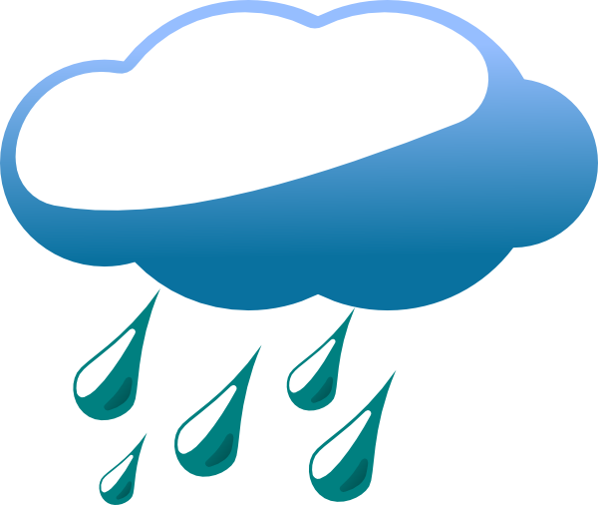
Naïve Bayes
Independence
50%
50%
50%
50%
60
Notes:
Now, going back to the independence assumption problem. Let's use a simple probability problem to understand this.
(click) Say you are trying to predict the weather as either sunny or rainy. Let's say on any random day, ignoring all other factors, the probability that it is sunny 50% and the probability that it is rainy is 50%.

Slide 61
Naïve Bayes
Independence
January 2nd
January 1st
50%
50%
50%
50%
61
Notes:
Next, say we want to calculate the probability that it is rainy on January 1st AND Janiary 2nd.

Slide 62
Naïve Bayes
Independence
P(Rain | )
January 1st
P(Rain | )
January 2nd
=50%
=50%
62
Notes:
Well, for each day, the probability that it rains is 50%. So can we say that the probability it rains on both days is 50% multiplied by 50%?

Slide 63
Naïve Bayes
Independence
P(Rain | January 1st AND Rain | January 2nd)
=45%
Is NOT
P(Rain | )
=25%
January 1st
*
P(Rain | )
January 2nd
63
Notes:
Actually, we CANNOT say this. If we simply multiply the probabilities, we are assuming that the two conditions are independent of each other. However, this assumption is clearly false because if it rains on one day, it is much more likely to rain on the next day. Our actual answer may be somewhere closer to (click) 45% rather than our calculated answer of (click) 25%.

Slide 64
Naïve Bayes
Classifier
$$=\frac{P\left(spam\right)P\left(nigerianprince | spam\right)P(offer|spam)}{P\left(nigerianprince\right)P(offer)}$$
$$P(spam|nigerianprince,offer)$$
conditional probabilities can be used as a classifier!
a classifier made this way, however, is “naïve” when extended to multiple features
multiplication for AND assumes independence!
“naïve”
64
Notes:
So, although the Naïve Bayes model is very powerful, it usually only works well when features of the training data are independent of each other. The assumption of independence makes the formula much simpler and makes the model a lot faster to run. However, in real life many features are not truly independent, so the result of the model may not be that accurate. This is a popular model in text analysis, such as spam filtering, sentiment analysis, etc.

Slide 65
5 ML Models for Classification
1. Decision Tree
2. Random Forest
3. Support Vector Machine (SVM)
4. Naïve Bayes
5. K Nearest Neighbors (KNN)
65
Notes:
That brings us to our final model, which is K Nearest Neighbors!!!!!

Slide 66
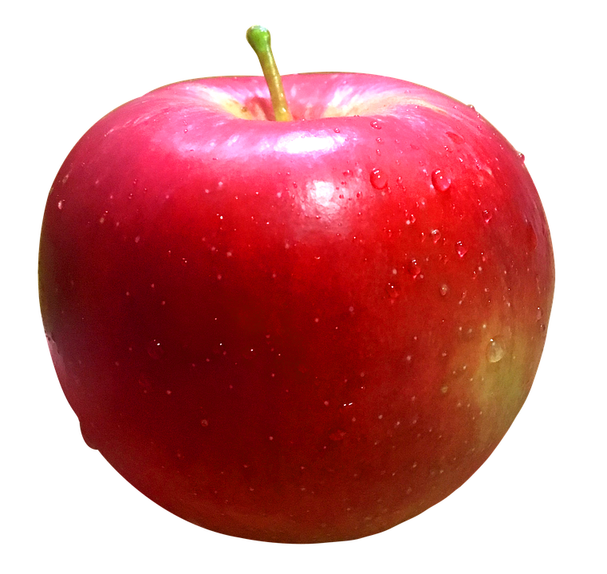
Buy?
Don’t buy?
66
Notes:
Once again, let's use an example to understand the model. This time, we are deciding whether or not to buy an apple.

Slide 67
Did Buy
Rejected
67
Notes:
To decide if we want to buy this apple, we might look at apples that were previously bought. Let's say these (click) were the apples that you did buy, and these (click) were the apples that were rejected.

Slide 68
Previously accepted
Previously rejected
68
Notes:
Let's put these apples on a graph to see them more clearly. (click *3)
Well, we can see that it seems like we previously rejected the apples that were larger, and we accepted the apples that were smaller. Now, the apple were are trying to classify seems to be slightly larger, so it would fit in the group of apples that were rejected (click).

Slide 69
We find the
K Nearest Neighbors
More related
Previously accepted
Previously rejected
69
Notes:
So we would classify this apple as a reject.
(click) This is the idea of the K Nearest Neighbors: comparing a new data sample to similar neighborinh data samples in order to classify it.

Slide 70



K Nearest Neighbors
Radius
Bounciness
70
Notes:
Let's look at this algorithm in more detail. This time, we are trying to classify a basketball into purchase or not purchase based on its bounciness and its radius.
In this graph, we plot existing data samples for different basketballs based on their bounciness and their radius. The green basketballs are basketballs that we would buy, and the red basketballs are those we would not buy.
We know the bounciness and radius of the new basketball we are trying to classify, so we can put it on the graph.

Slide 71
K Nearest Neighbors
another hyperparameter
Radius
K=5
Buy
Bounciness
71
Notes:
Now that it's on the graph, we can compare it to its neighboring basketballs. Specifically, we compare the ball to its k nearest neighbors. (click) K is a hyperparameter which we can control, but let's iust say K = 5. (click)
These are the 5 nearest neighbors. (point) Out of these 5 nearest neighbors, 3 of them are "buy" and two are "not buy". Because the majority of the neighbors are "buy", you would classify the new ball as "buy".
What about if K=7?

Slide 72
K Nearest Neighbors
another hyperparameter
Radius
K=7
Don’t Buy
Bounciness
72
Notes:
These are the nearest neighbors. Should we buy this ball or not buy?
Take answers
As you can see, our classification changed based on the value of K, so it's really important to choose the optimal value of k that is not too small or not too big.
Compared to the previous models, this model is non-parametric. That means it's not trying to fit a line or boundary to the data, it is simply comparing the new samples to the neighbors to come up with a prediction. This model is one of the most simple machine learning models, but the key is to find the best value for k.

Slide 73
Five classifiers! That’s a lot.
Let’s get to the lab!
73
Notes:
Let’s get to the lab

